Slide 1
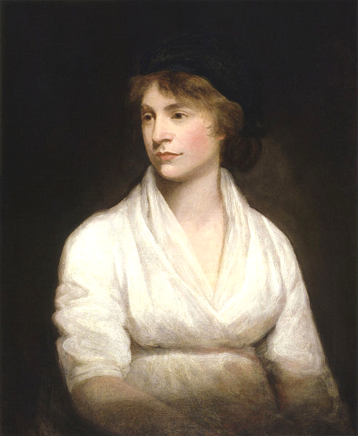
Women
and the
French
Revolution

Slide 2
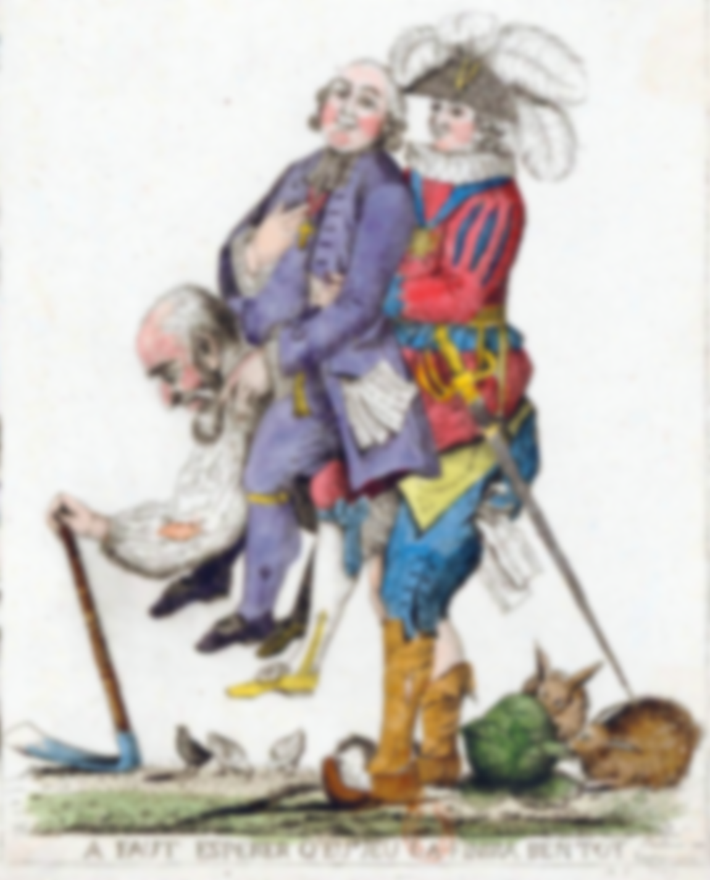
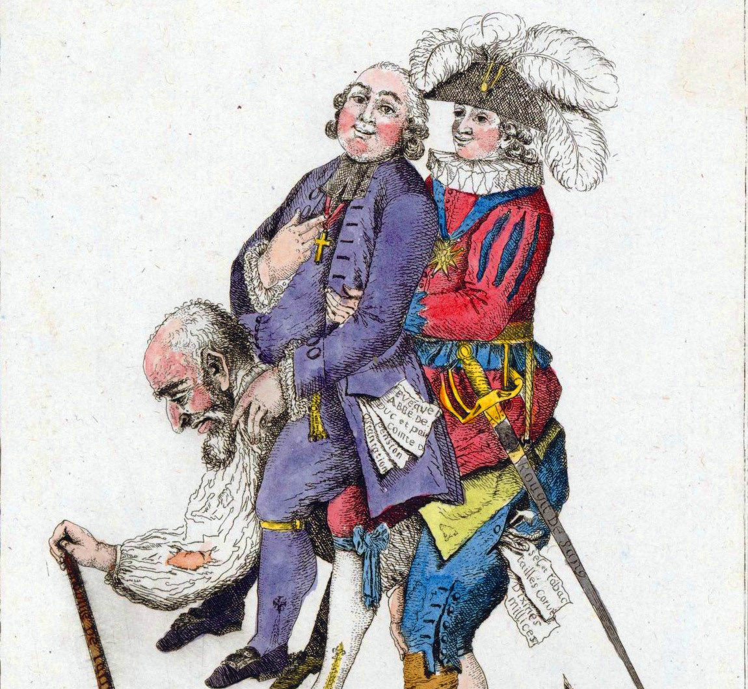
Under the Old Regime
All men were not EQUAL

Slide 3
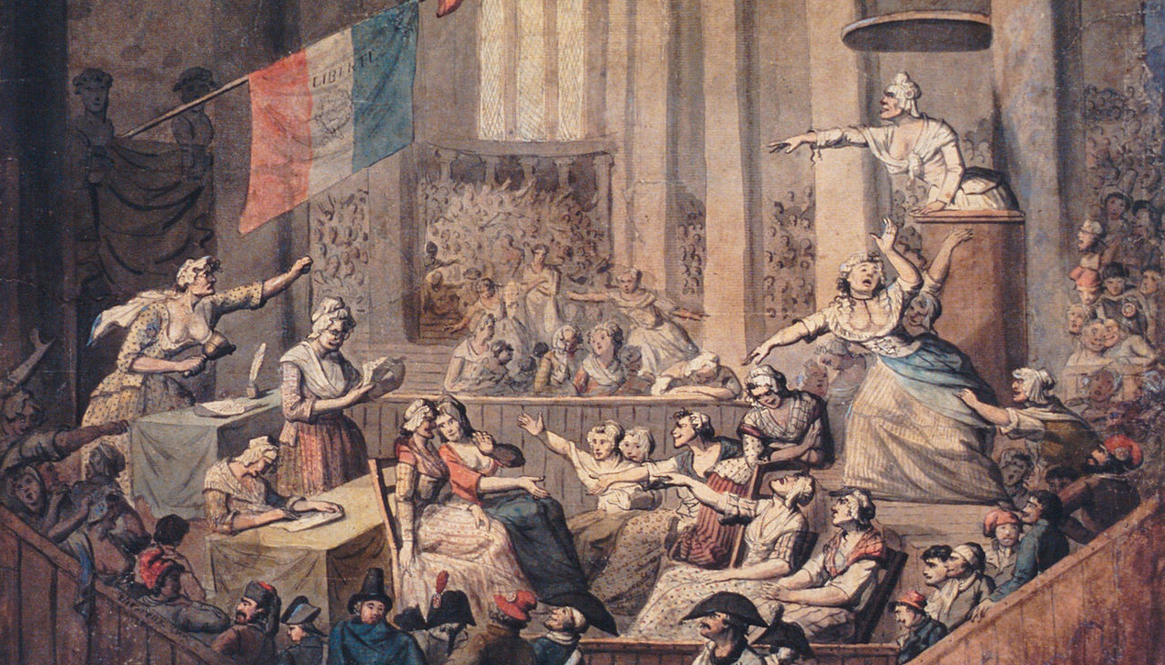
Much Less Women

Slide 4


SEPARATE SPHERES

Slide 5
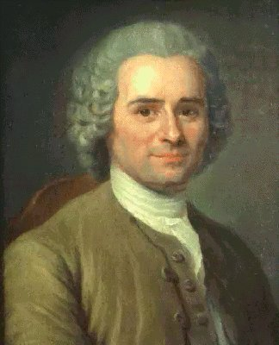
Rousseau
  (French Philosophe)
Emile (On Education)
“Mother, do not make a decent man out of your daughter. Make a decent woman out of her.”

Slide 6
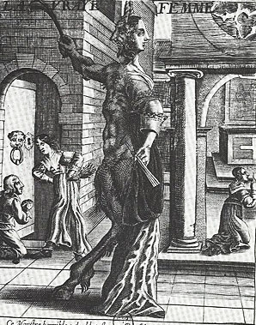
An Early Modern
View of Women
The True Woman, anonymous engraving, seventeenth century. Paris, Bibliothèque Nationale

Slide 7
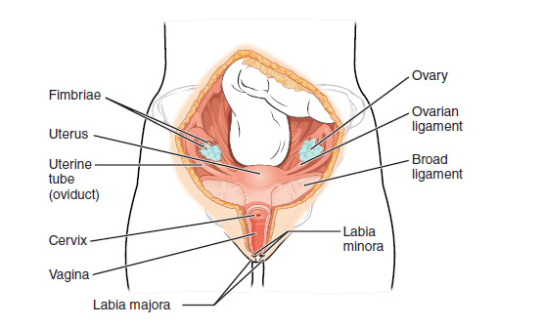
HYSTERICAL
Illustration from Anatomy & Physiology, Connexions Web site. http://cnx.org/content/col11496/1.6/

Slide 8
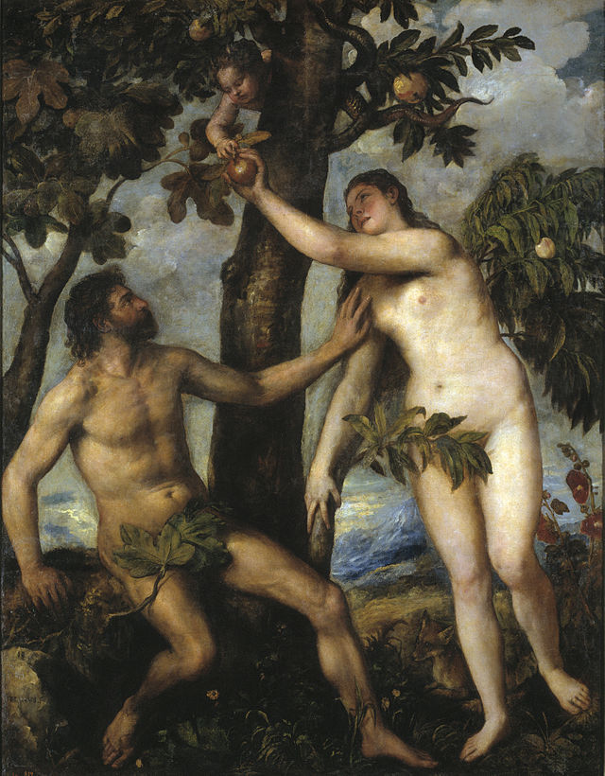
APPLE!

Slide 9
NO!

Slide 10
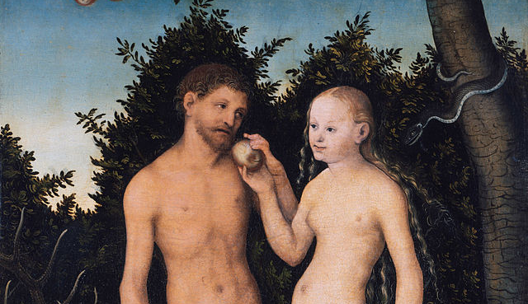
Okay… I’ll try it.

Slide 11
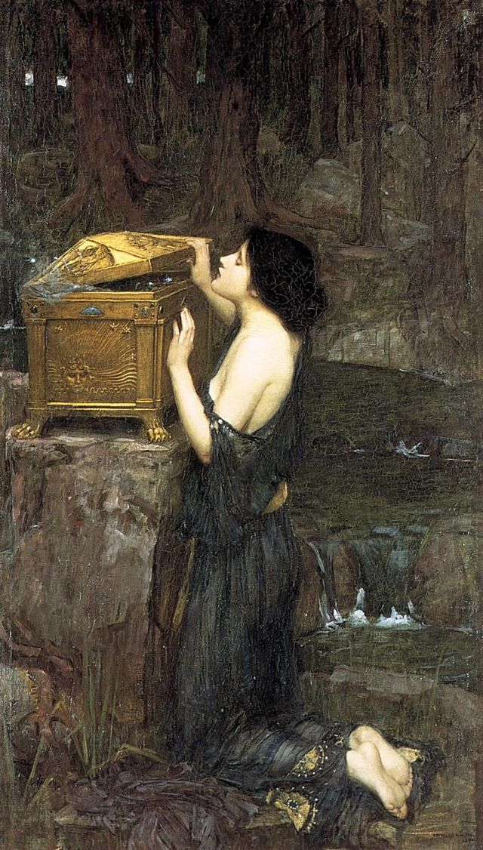
The Greek Version

Slide 12
CORRUPTING INFLUENCE

Slide 13
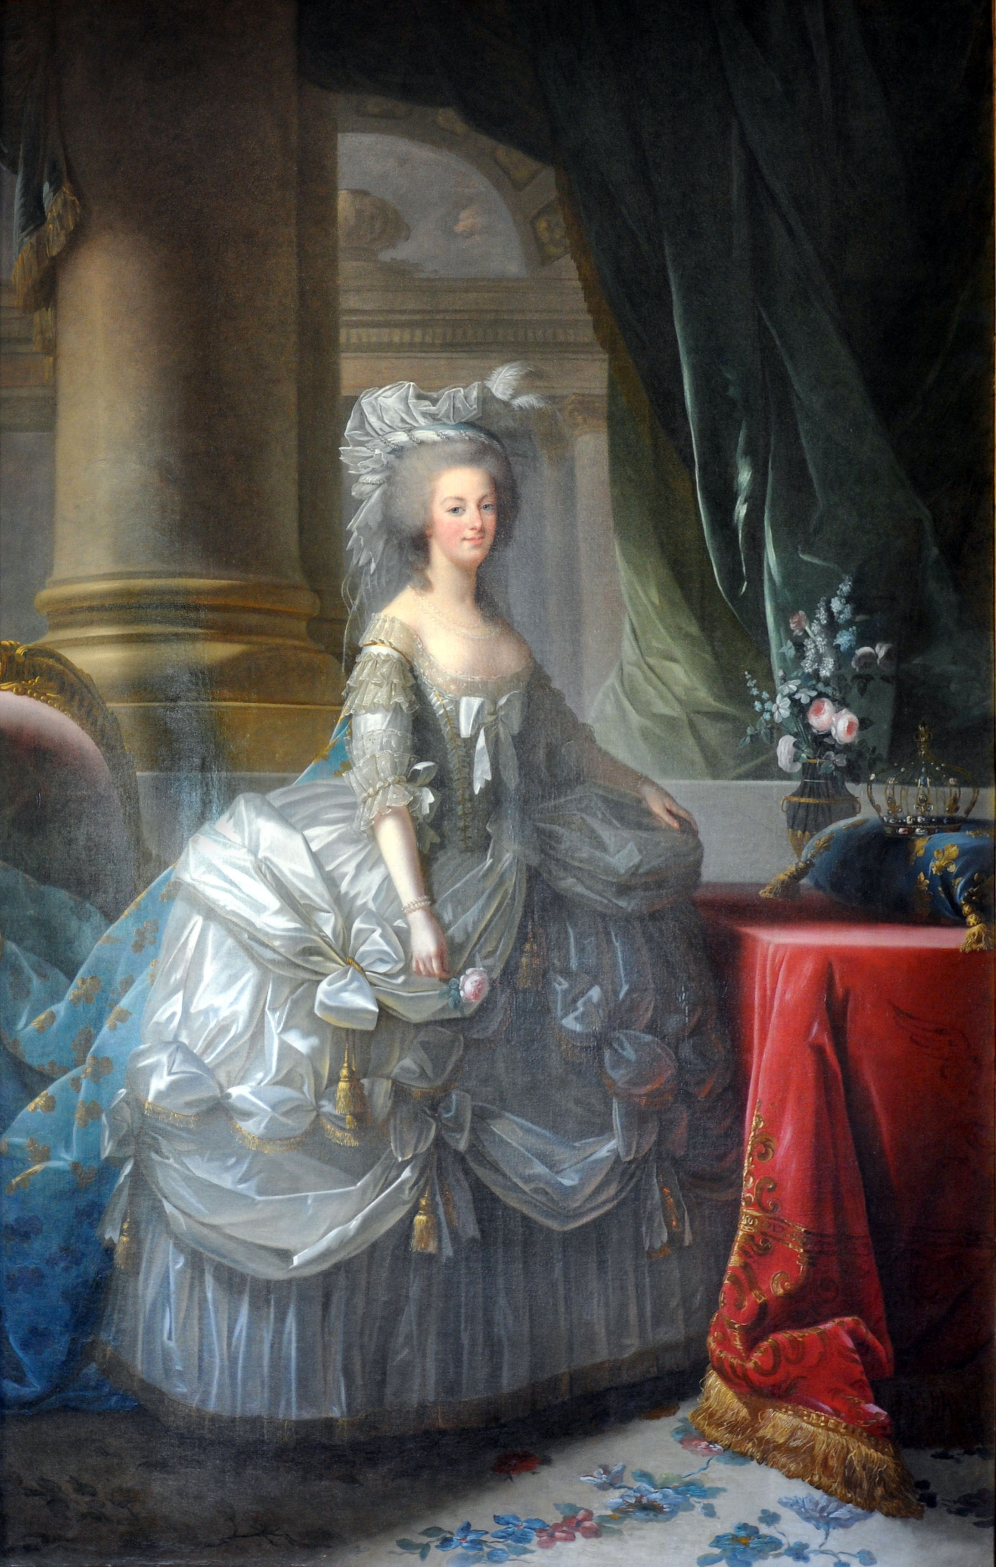
Marie Antoinette
Tragic Queen of France

Slide 14
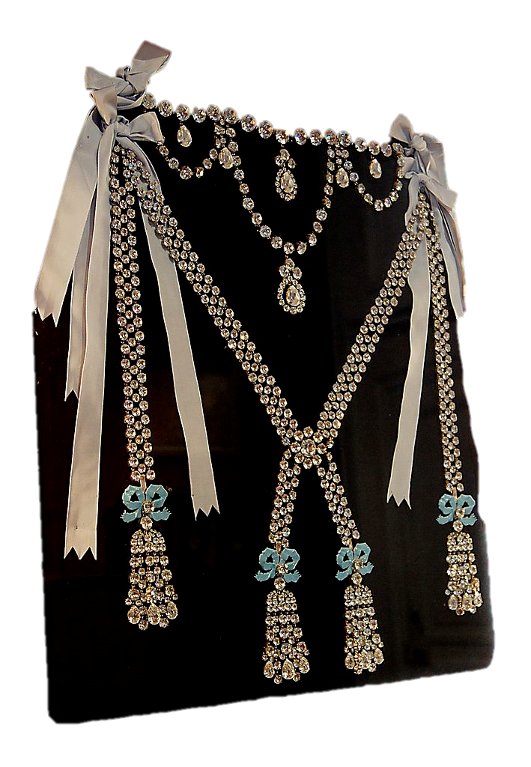
Diamond
Necklace
Affair
The queen’s name was further tarnished when she became associated with an attempted fraud that had taken place without her knowledge.

Slide 15

LET THEM
Some rights reserved by St0rmz

Slide 16
Marie Antoinette became a symbol for the French monarchy’s extravagance in hard times.
Some rights reserved by St0rmz

Slide 17
Madame
Deficit

Slide 18
L’Autrichienne
The Austrian “woman”

Slide 19

Chienne
A chienne nursing puppies
Photo by Robin Taylor

Slide 20
L’Autrichienne
GET IT???
#PUN

Slide 21
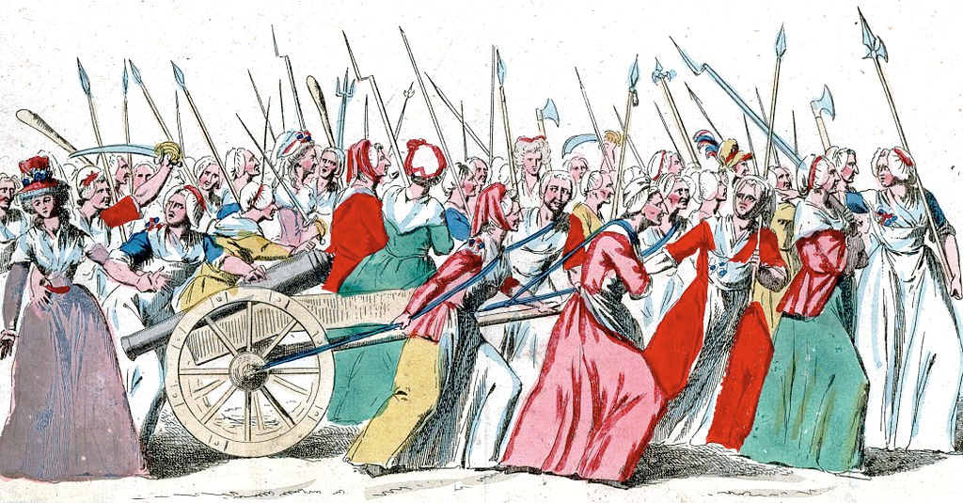
Women’s March on Versailles
October 5, 1789
An angry mob of armed women demanded that the king and queen vacate Versailles and come with them to Paris.

Slide 22
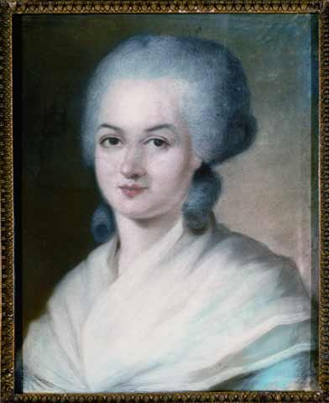
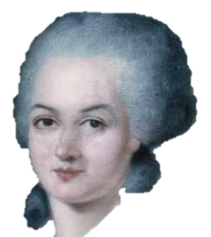
Olympe de Gouges
Declaration of the Rights of Woman and the Female Citizen
“Woman has the right to mount the scaffold; she must equally have the right to mount the rostrum.”
View Document

Slide 23
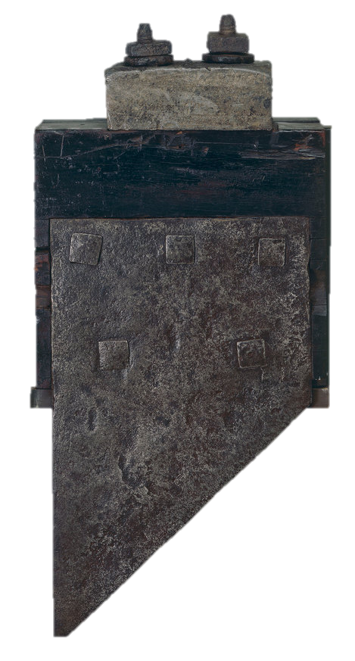

Olympe de Gouges
BEHEADED
(1793)

Slide 24

The British
Debate

Slide 25
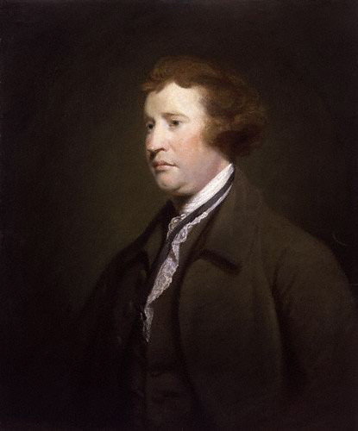
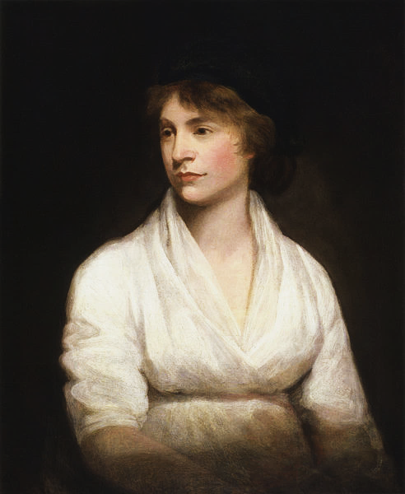
Burke vs. Wollstonecraft

Slide 26
Edmund Burke
Reflections on the Revolution in France
(1790)

Slide 27
Edmund Burke
Reflections on the Revolution in France
(1790)
ANTI

Slide 28
Edmund Burke
Conservatism
Inherited Rights

Slide 29
Mary Wollstonecraft
A Vindication of the Rights of Man
(1790)

Slide 30
Mary Wollstonecraft
PRO
A Vindication of the Rights of Man
(1790)

Slide 31
Mary Wollstonecraft
Liberalism
Natural Rights

Slide 32
That was fun...

Slide 33
Mary Wollstonecraft
A Vindication of the Rights of Woman
(1792)

Slide 34
Even MORE fun!

Slide 35
Women’s Political Clubs

Slide 36
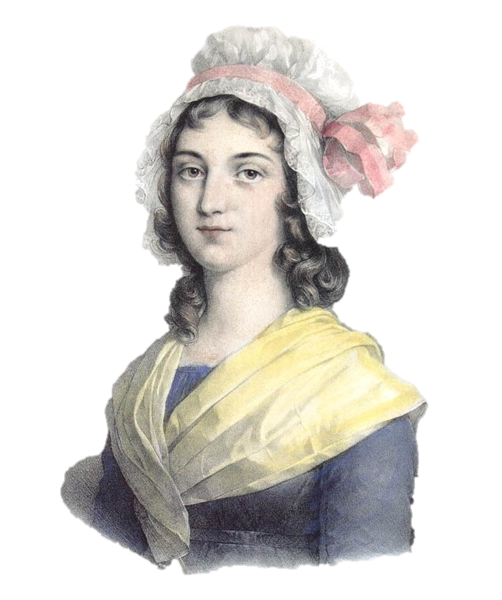
Charlotte Corday
ASSASSINATED
Jean-Paul Marat
(a Jacobin fanatic)
in 1793

Slide 37
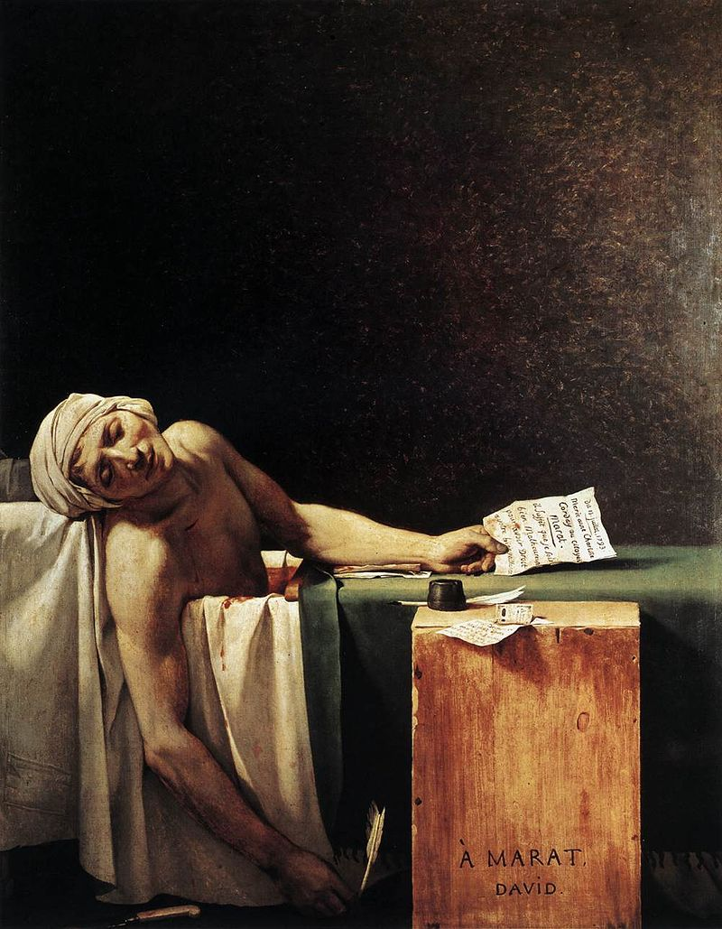
The Death of Marat
Jacques-Louis David
(1793)

Slide 38
A Jacobin Saint

Slide 39
I have killed
one man
to save
a hundred thousand.

Slide 40
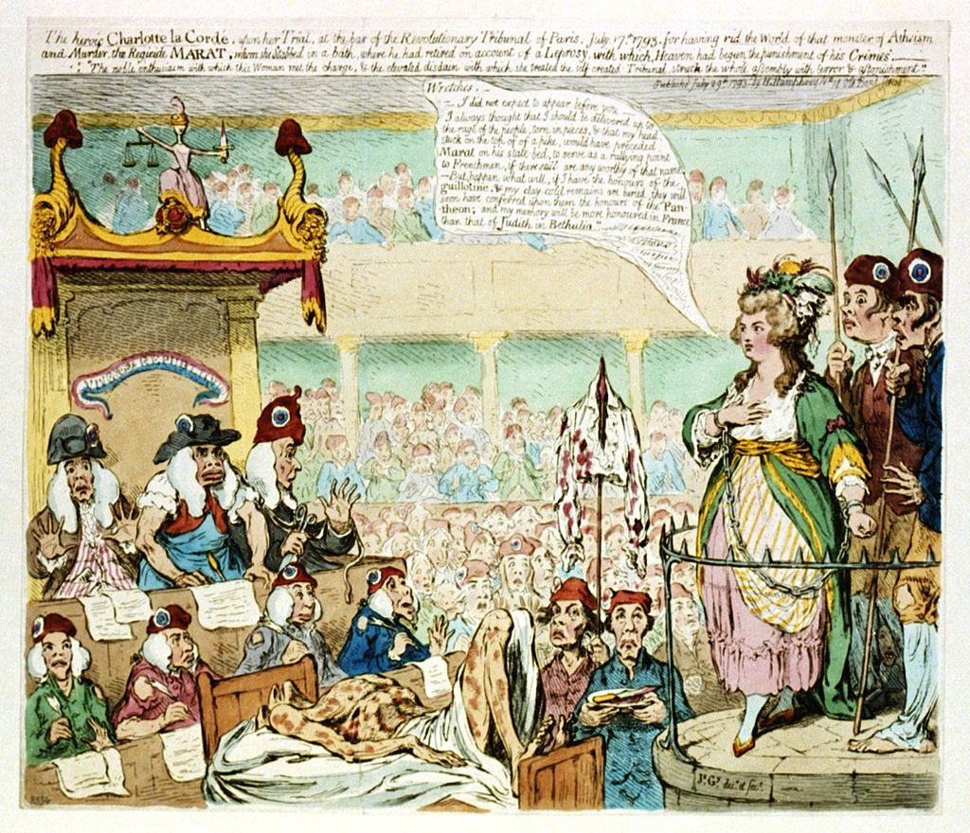
An English Perspective
Caricature of Corday's trial by James Gillray
(1793)

Slide 41
The heroic Charlotte la Cordé, upon her trial, at the bar of the revolutionary tribunal of Paris, July 17, 1793
For having rid the world of that monster of Atheism and Murder, the Regicide Marat, whom she stabbed in a bath, where he had retired on account of a Leprosy, with which Heaven had begun the punishment of his Crimes. "The noble enthusiasm with which this woman met the charge, & the elevated disdain with which she treated the self-created Tribunal, struck the whole assembly with terror & astonishment.

Slide 42
“Wretches – I did not expect to appear before you – I always thought that I should be delivered up to the outrage of the people, torn in pieces, and that my head, stuck on top of a pike, would have preceded Marat on his state bed, to serve as a rallying point to Frenchmen, if there still are any worthy of that name. -- But happen what will, if I have the honours of the guillotine, and my clay-cold remains are buried, they will soon have conferred upon them the honours of the Pantheon; and my memory will be more honored in France than that of Judith in Bethulia.”

Slide 43
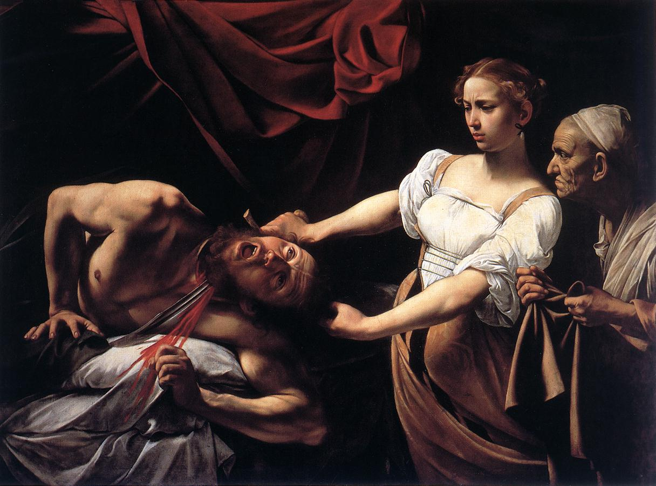
Judith
Caravaggio, Judith Beheading Holofernes (1599)

Slide 44
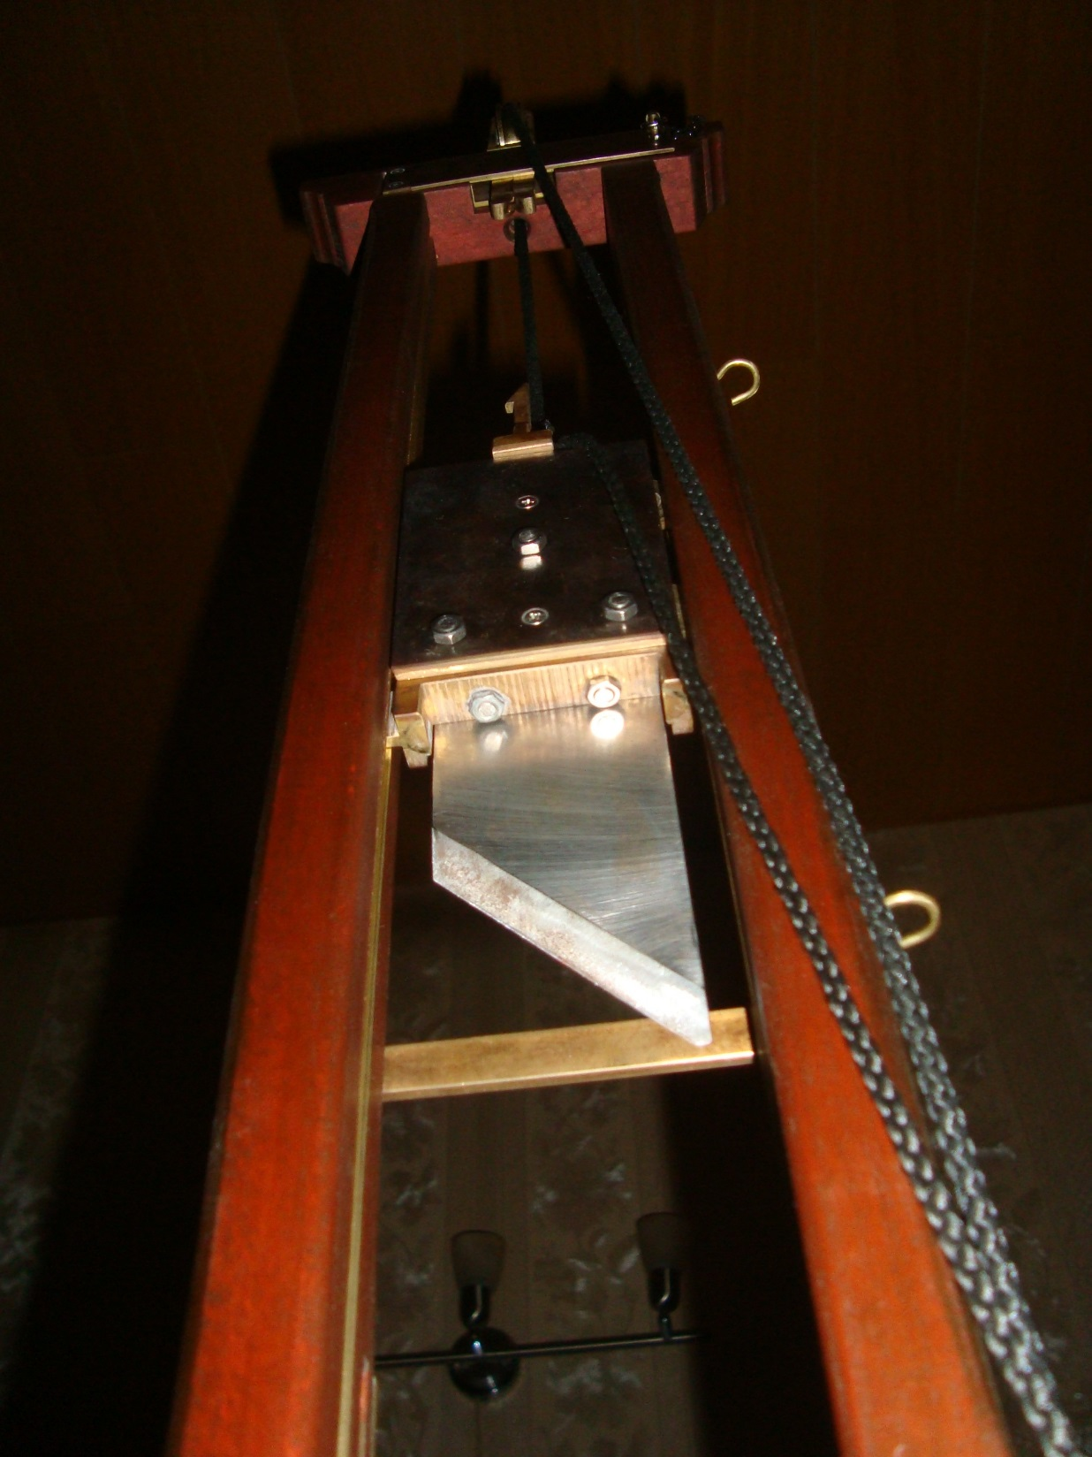
Revolutionary leaders of the day did not see Corday as a hero.
Photo by E. C.

Slide 45
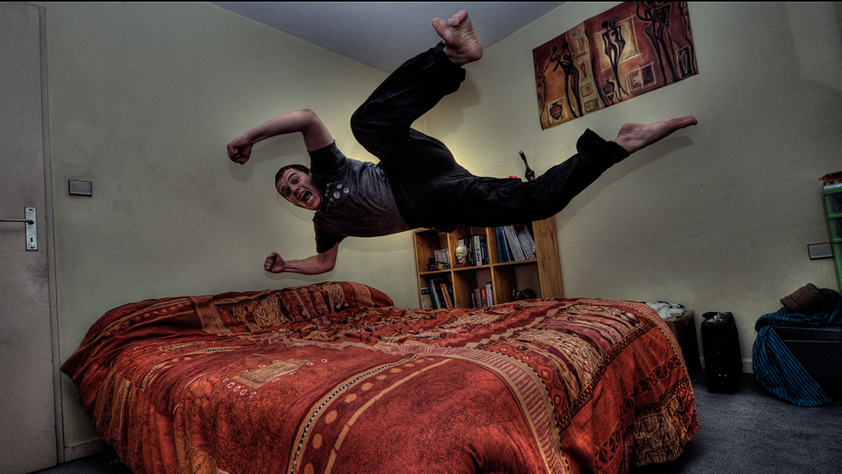
A man must have put her up to it...
Photo by Grégory Tonon

Slide 46

NO
Photo by Prayitno

Slide 47

French authorities were disappointed to find no evidence that Corday had ever shared a bed with a man.
Photo by Prayitno

Slide 48

And afraid of the idea of women being able to do such things on their own.
Photo by Capture Queen

Slide 49
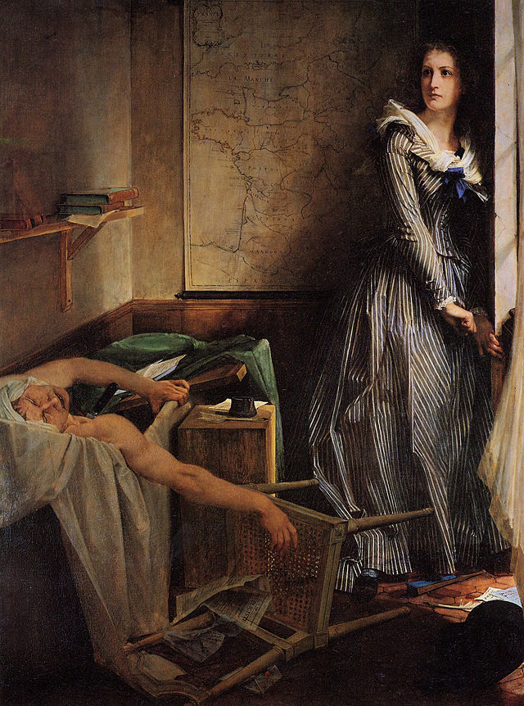
REVISIONISM
The French Reconsider

Slide 50
Corday as
National
Heroine
Charlotte Corday by Paul Jacques Aimé Baudry (1860)

Slide 51
Corday as
National
Heroine
Champion
of reason
FANATIC
Charlotte Corday by Paul Jacques Aimé Baudry (1860)

Slide 52
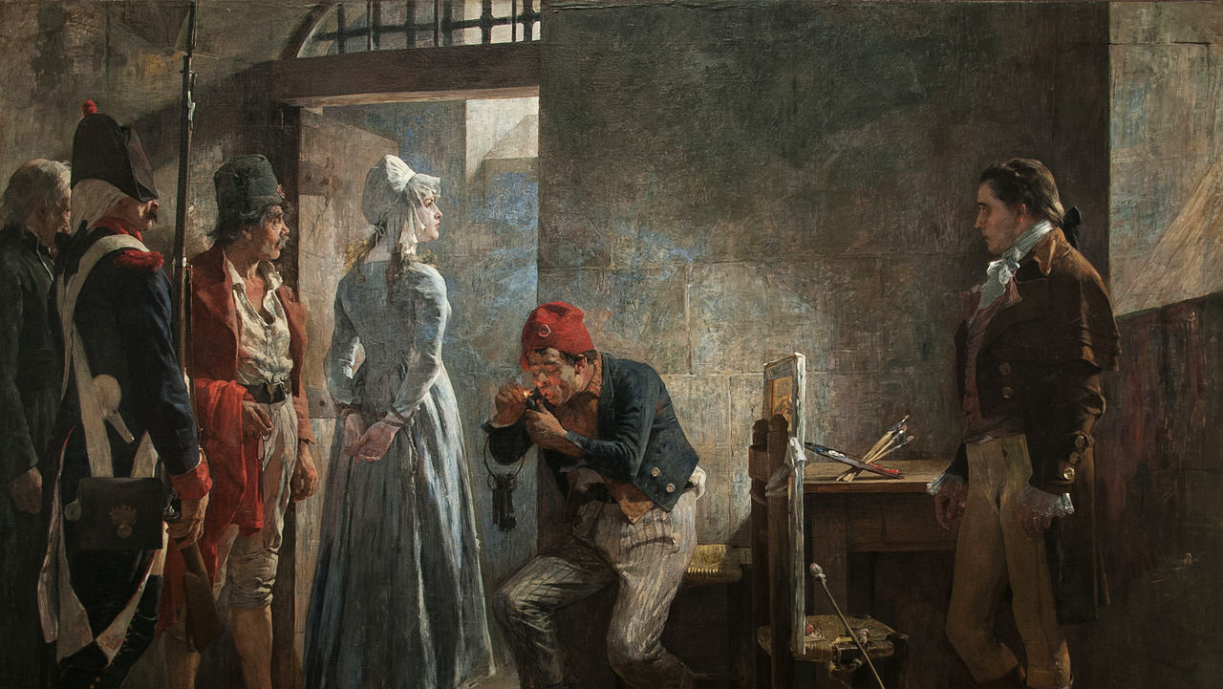
Ain’t no thang!
Arturo Michelena, Charlotte Corday being conducted to her execution (1889)

Slide 53
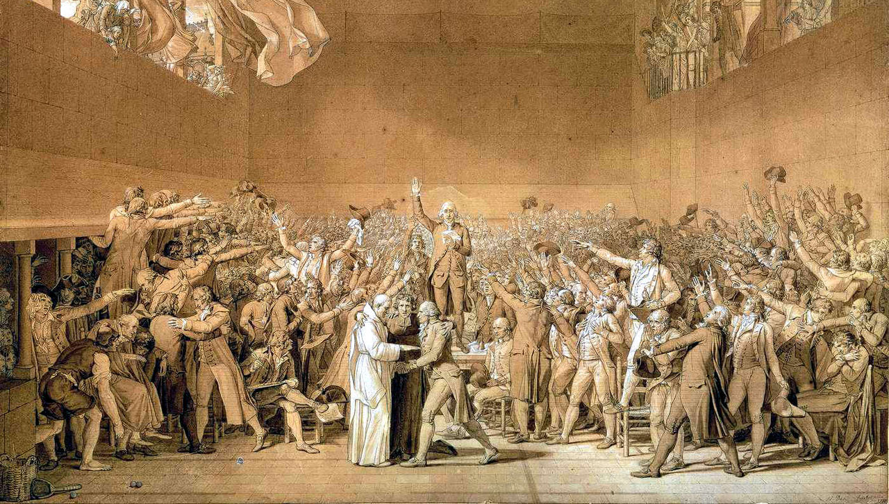
The French Revolution was not a feminist revolution

Slide 54
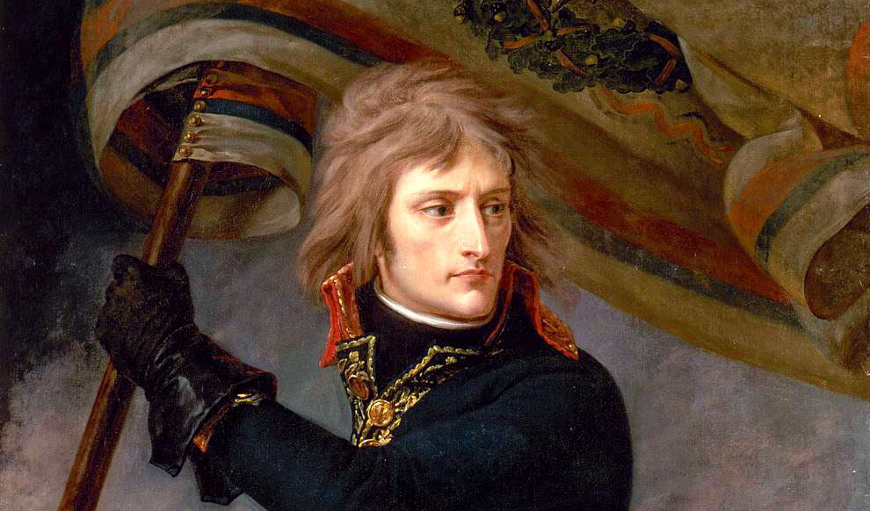
DEFINITELY NOT

Slide 55
But it was a start

Slide 56
Women began the Revolution as
Villains

Slide 57
And walked out of it as
HEROES

Slide 58
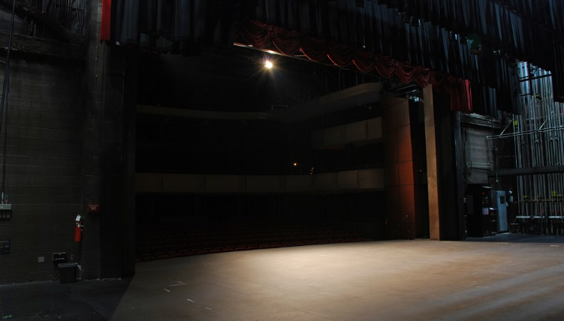
The stage was set for the feminist movement.
Photo by Max Wolfe

Slide 59

LEARNING. DELIVERED.

