Slide 1
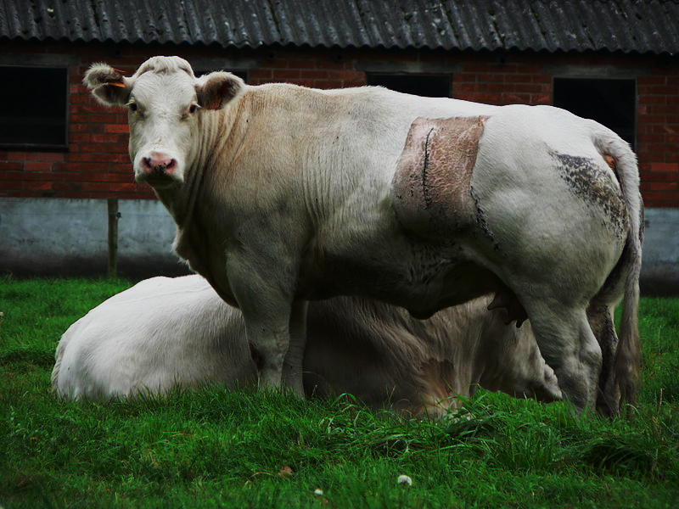
The [British] Agricultural Revolution
AP European History

Slide 2
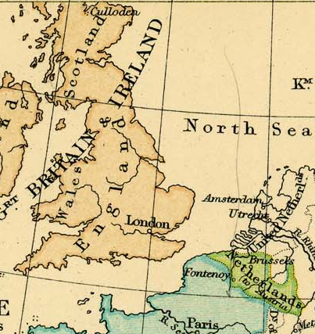
Innovation
Origins (17th century):
England
“Low Countries”

Slide 3
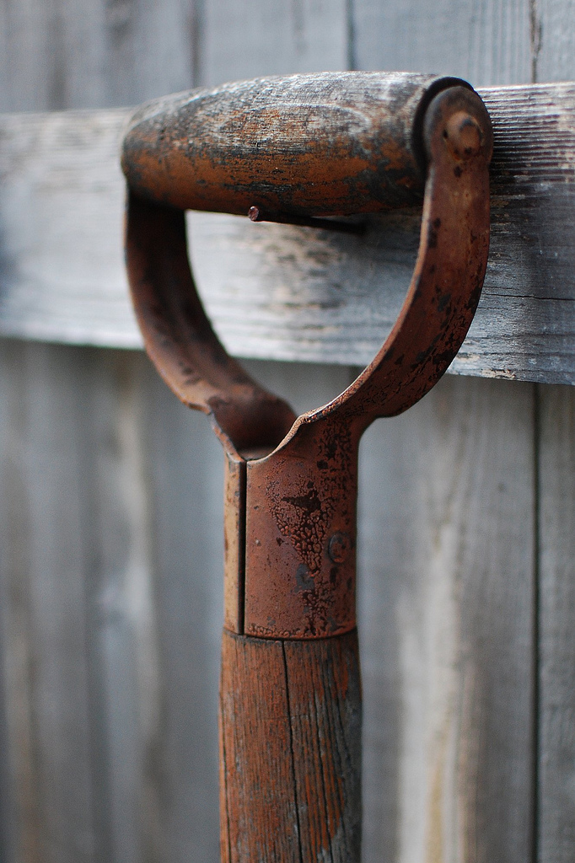
All SET
The keys to Understanding the Agricultural Revolution:
Science
Entrepreneurship
Technology
Photo Credit: Nineminutes

Slide 4
Agricultural Innovation
The Farmer as Scientist
Photo Credit: Sean Church
Notes:
http://grist.org/article/food-2010-12-29-farmer-scientists-want-to-hack-society/

Slide 5
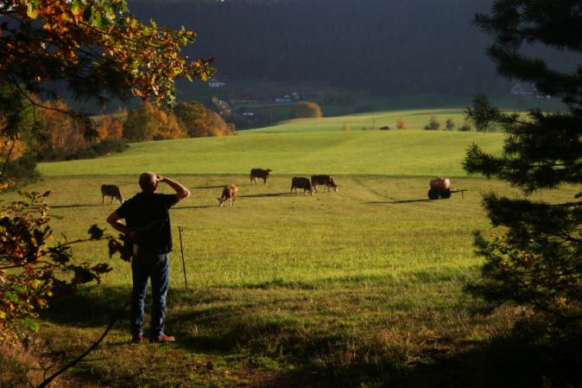
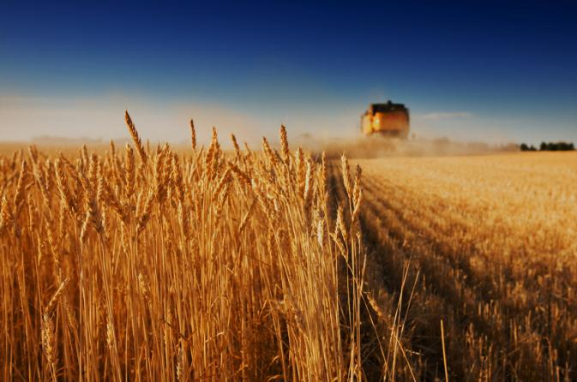
Three-Field Crop Rotation
(Middle Ages)
3
Wheat
1
Oats
Fallow
Wheat
Oats
2
Fallow
OUT with the old.
Wheat
3
Oats
Fallow
Notes:
Article on Crop Rotation: http://www.medievalists.net/2010/08/17/the-economics-of-exhaustion-the-postan-thesis-and-the-agricultural-revolution/

Slide 6
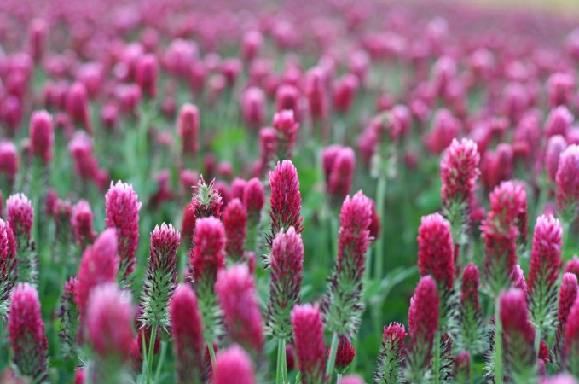
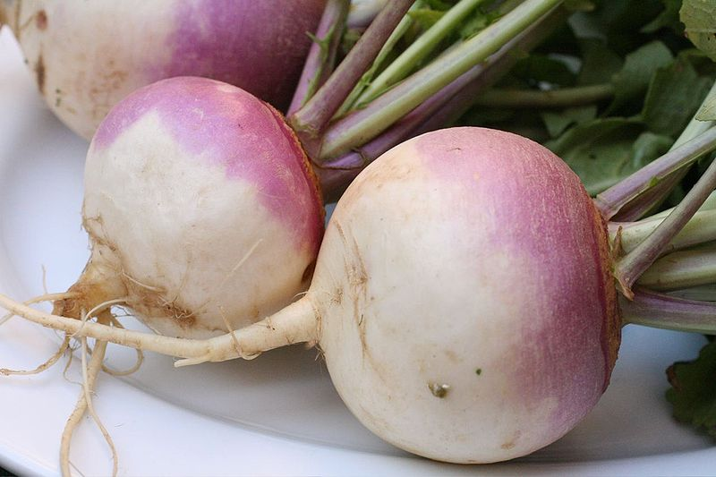
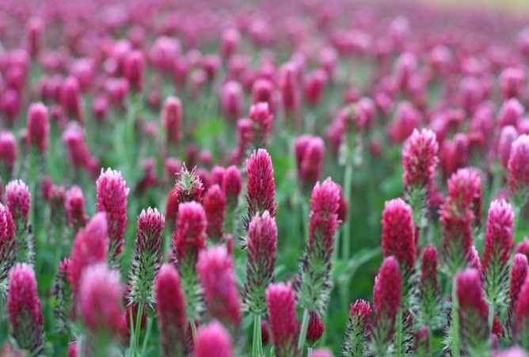
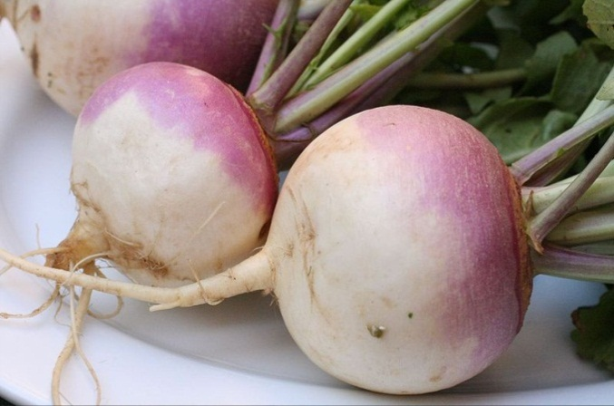
Four-Field Crop Rotation
(Seventeenth Century)
4
Wheat
Wheat
Clover
Clover
Turnips
Oats
Oats
Turnips
Photo Credit: Dan Klimke
Photo Credit: Dan Klimke
Wheat
Wheat
Clover
Clover
Oats
Oats
IN with the new!
Turnips
Turnips
Photo Credit: Dan Klimke
Photo Credit: Dan Klimke
1
2
3
4
Notes:
Article: http://www.saburchill.com/history/chapters/IR/003f.html Clover Field Photo Credit: Dan Klimke

Slide 7
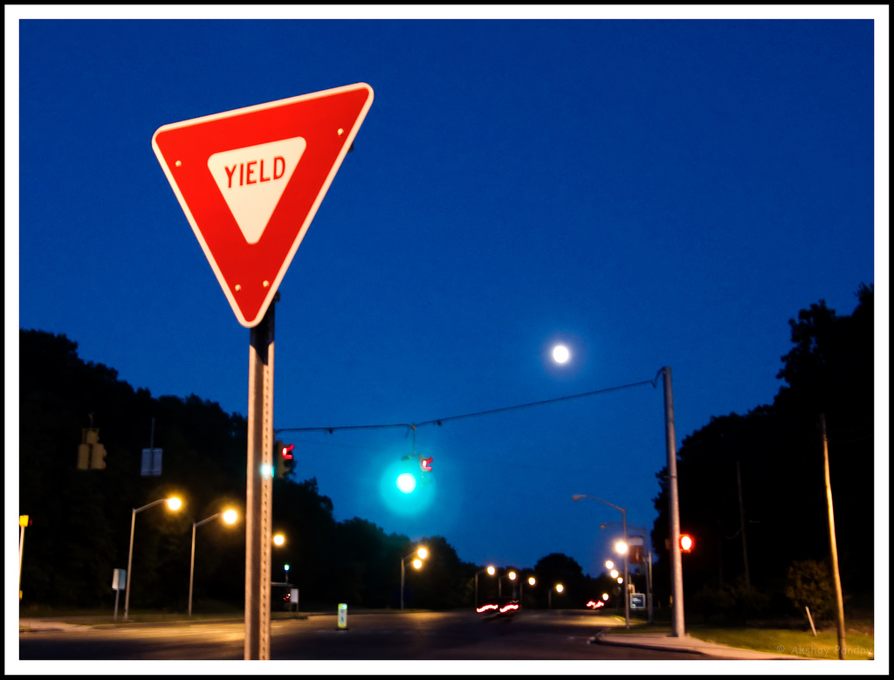
=
More Fields
More Food
The four-field system produced a higher crop yield because none of the land had to lie fallow.
By theakshay

Slide 8
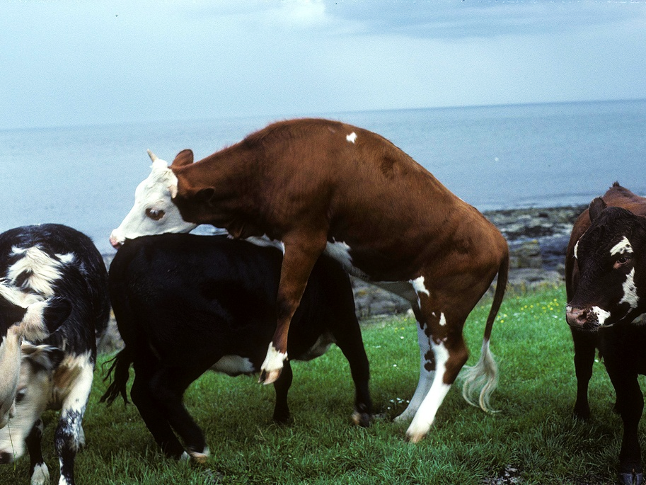
There’s GOT to be a better way...
Photo Credit: Julian Stallabrass

Slide 9
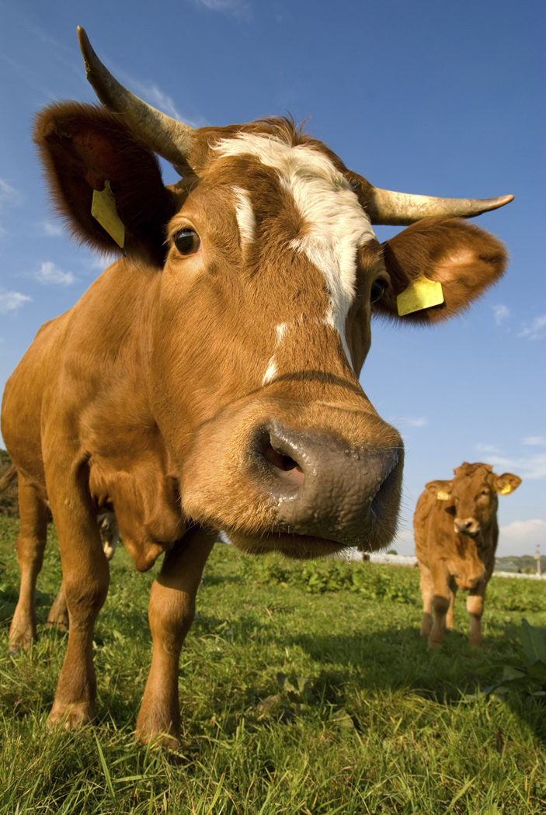
Selective Breeding
The application of scientific principles to agriculture

Slide 10
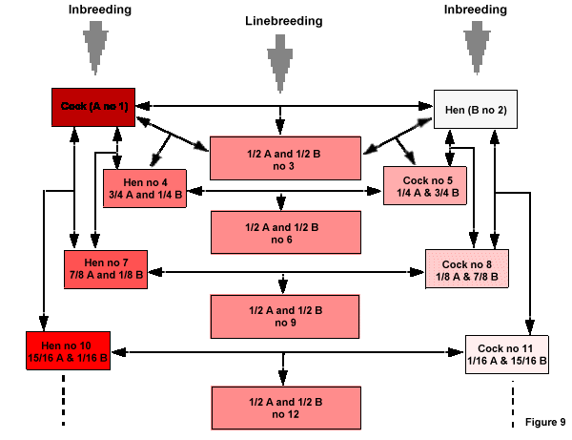
Science
Woo Hoo!!!
Notes:
http://digilander.libero.it/avifauna/articoli_ornicoltura/PHTright7.html

Slide 11
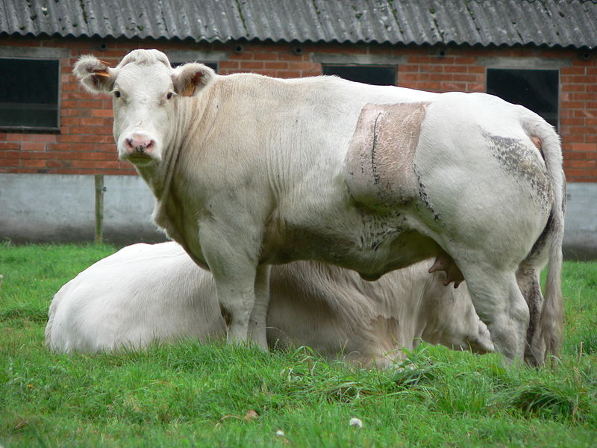
Belgian Blue
I have a genetic defect that’s been perpetuated by selective breeding. THANKS, SCIENCE!
Photo by Barbarossa
Notes:
A Belgian Blue cow. The defect in the breed's myostatin gene is maintained through linebreeding and is responsible for its accelerated lean muscle growth.

Slide 12
Much Better
Photo Credit: Sean Church

Slide 13
Agricultural Innovation
The Farmer as Entrepreneur
Photo Credit: Sean Church
Notes:
http://grist.org/article/food-2010-12-29-farmer-scientists-want-to-hack-society/

Slide 14
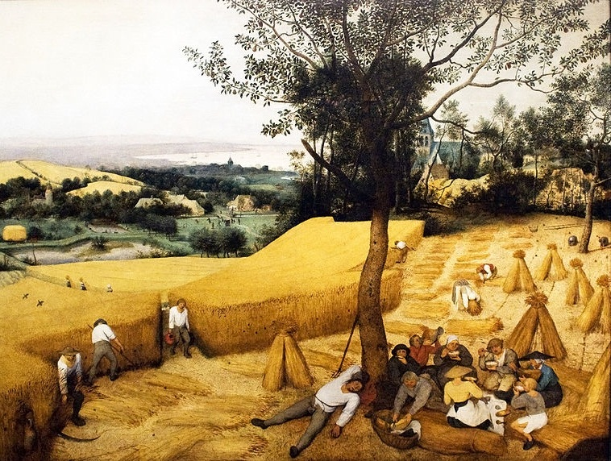
Traditional Agriculture
Bruegel, The Harvesters (1565)
Notes:
Pieter Bruegel the Elder, The Harvesters (1565)

Slide 15
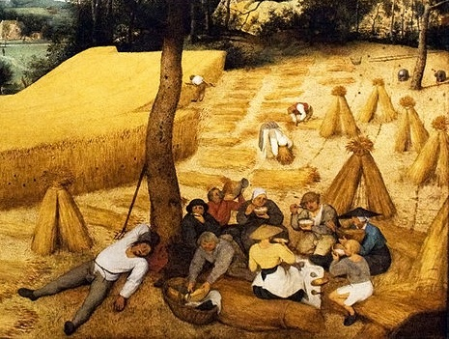
It’s Break Time!
Notes:
Pieter Bruegel the Elder, The Harvesters (1565)

Slide 16
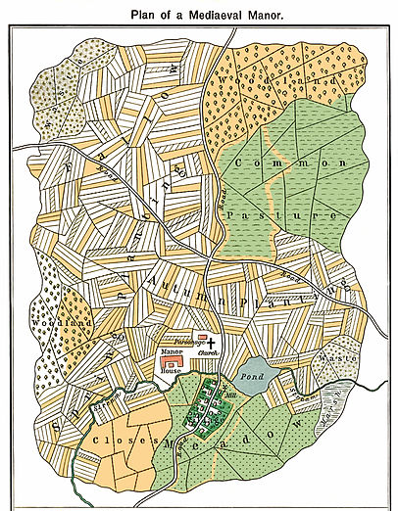
The Common Pasture
The Old Way

Slide 17
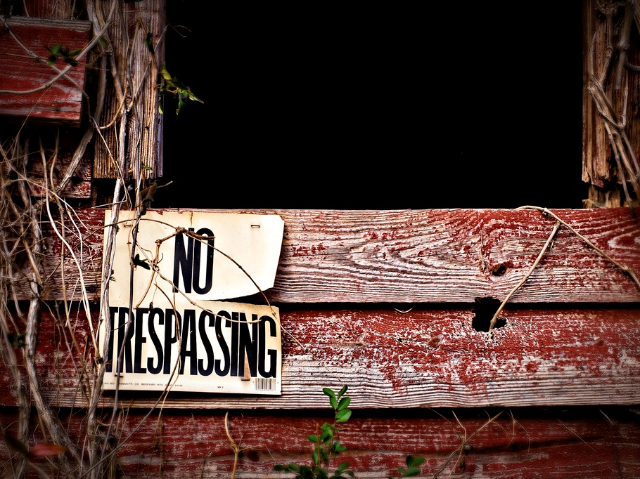
Enclosure Movement
The New Way
Photo Credit: Craig Maccubbin

Slide 18
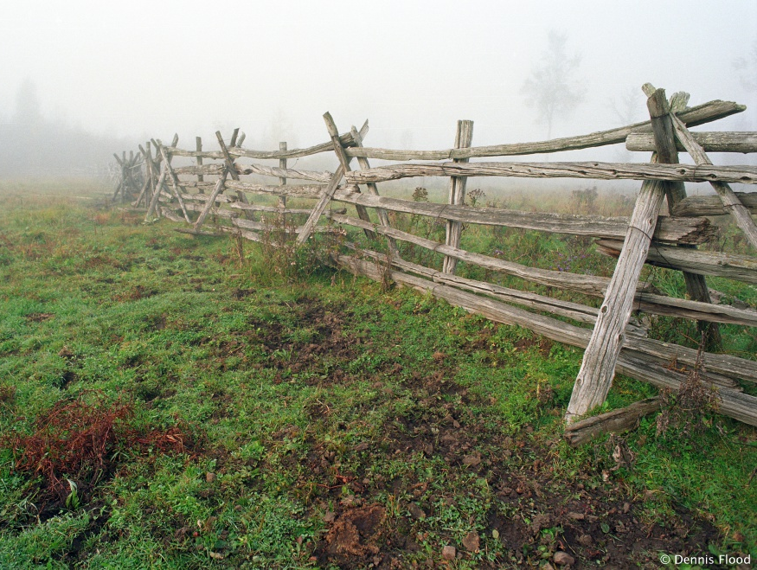
Enclosure Movement
THE DOWNSIDE:
Hurt poor farmers who lost grazing rights for their cattle on the common land
THE UPSIDE:
Agricultural production, as a whole, became more market-oriented and efficient.
Photo Credit: http://www.dennisflood.com/photos/2003/1000/foggy_wooden_fence.jpg

Slide 19
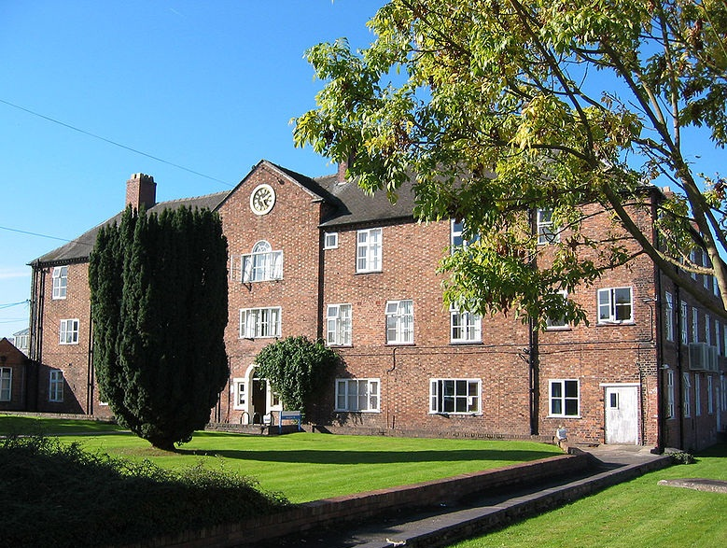
English Poor Laws
Workhouses, such as this one, provided shelter and employment for the able-bodied poor.

Slide 20
=
Bigger Farms
More Food
Large landowners were able to make use of the latest developments in science and technology, producing higher crop yields.
By theakshay

Slide 21
Agricultural Innovation
The Farmer as Inventor
Photo Credit: Sean Church
Notes:
http://grist.org/article/food-2010-12-29-farmer-scientists-want-to-hack-society/

Slide 22
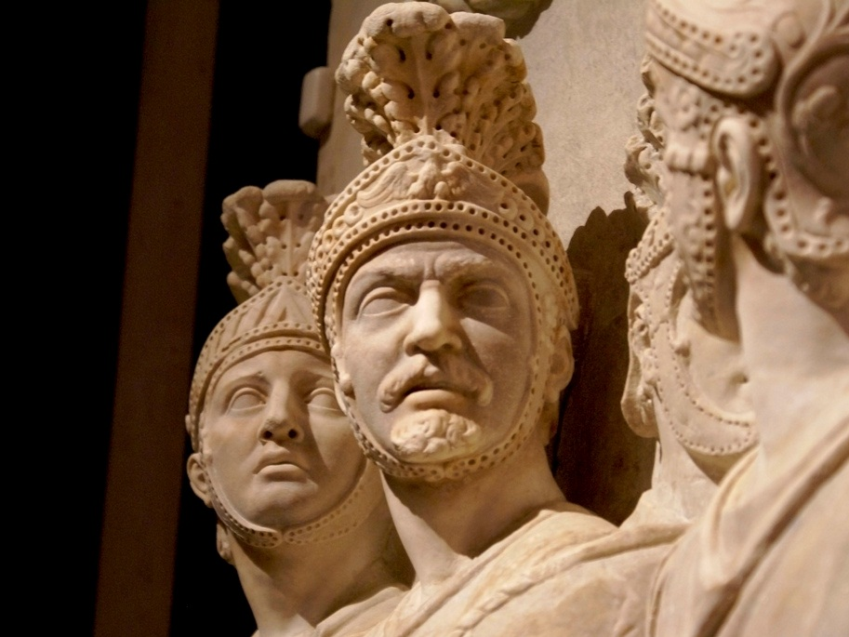
Hello, Innovation!
It’s been awhile...
Photo Credit: Galdo Trouchky

Slide 23
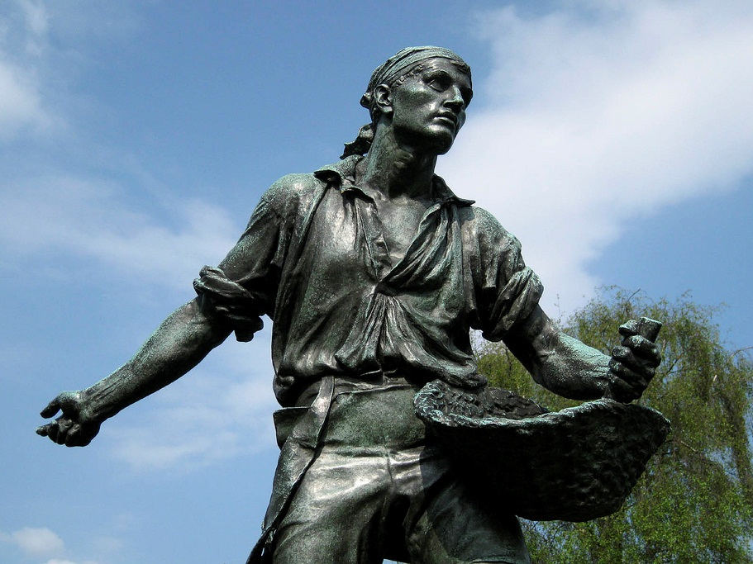
The Sower
By mira66

Slide 24
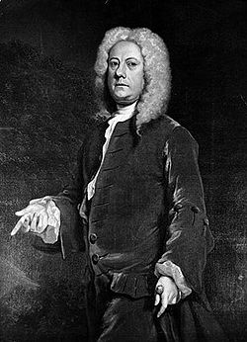
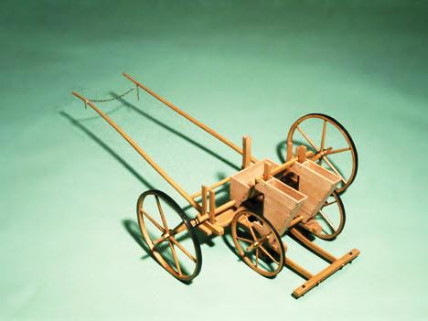
Jethro Tull’s Seed Drill
Jethro Tull (1674-1740)
Tull’s horse-drawn seed drill made sowing seed more efficient and precise.
Photo Credit: Science Museum/Science & Society Picture Library (UK)

Slide 25
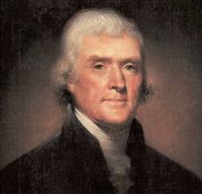
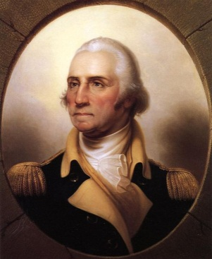
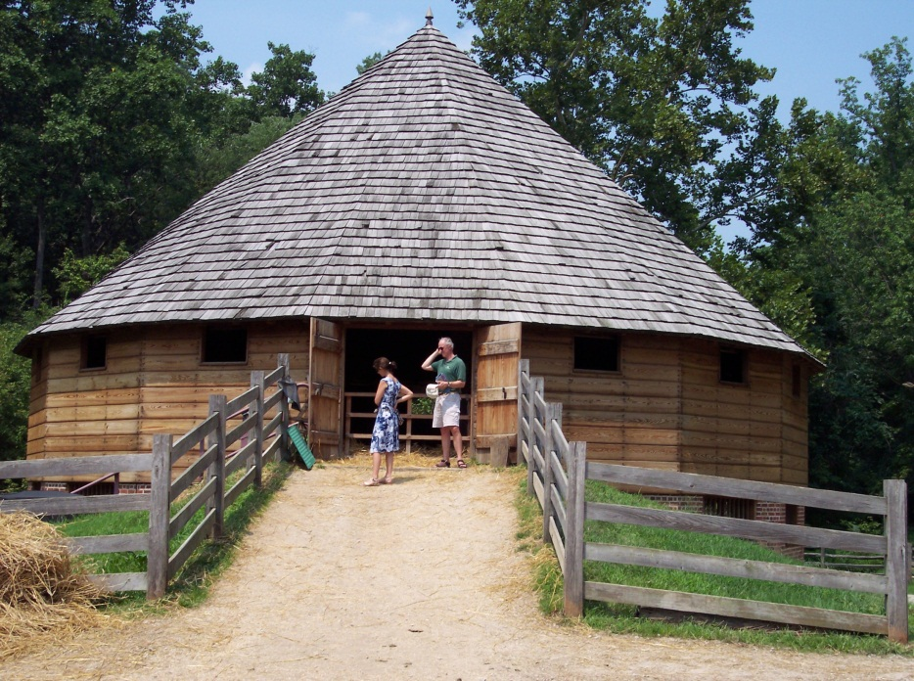
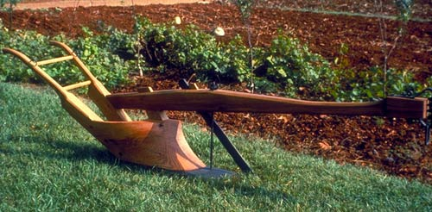
Agricultural Inventions
In the United States
16
Jefferson’s Moldboard Plow

Slide 26
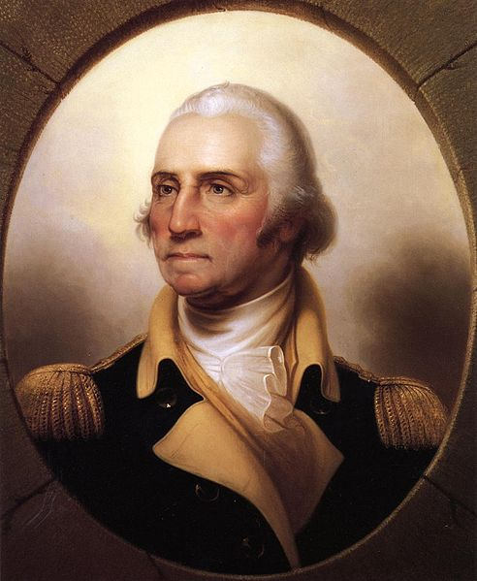
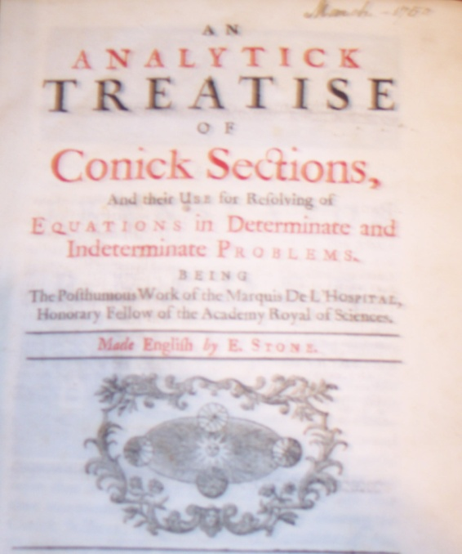
16
A mathematics text from Washington’s library

Slide 27
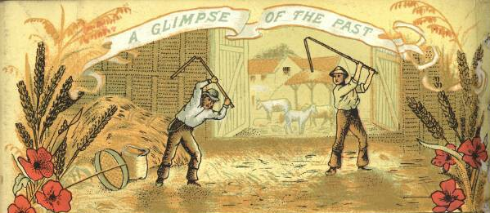
Threshing Wheat
Before the Scientific Revolution

Slide 28
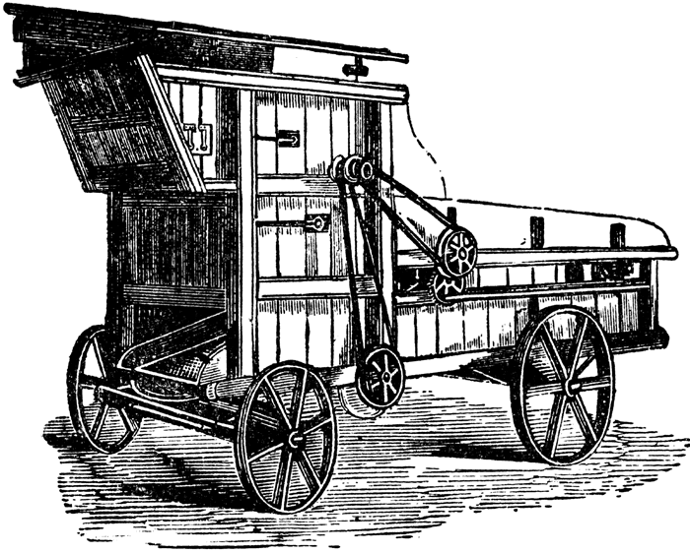
Portable Threshing Machine
A lot less complicated than a sixteen-sided barn, but not nearly as cool!

Slide 29
=
Better Tools
More Food
Technological inventions like Tull’s seed drill resulted in more efficient agricultural practices, producing higher crop yields.
By theakshay

Slide 30
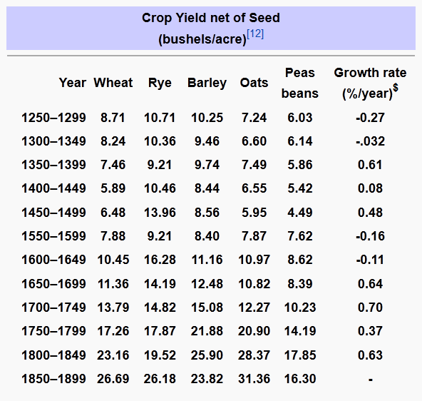

Slide 31
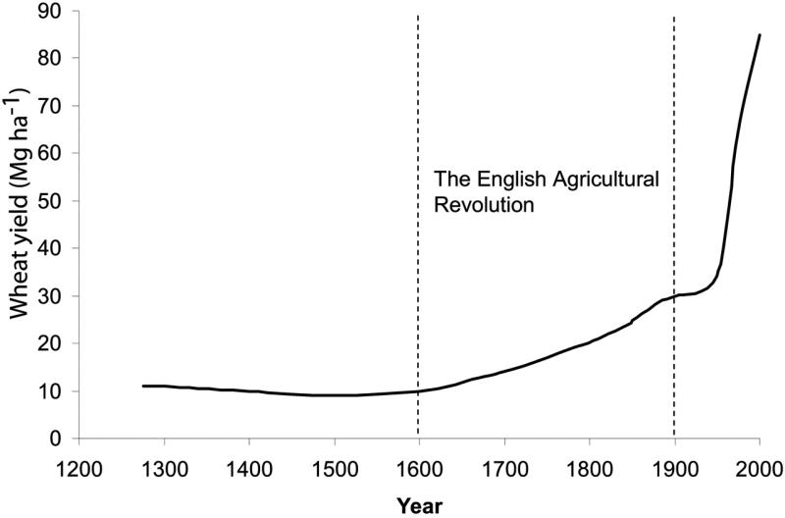
Source: https://www.agronomy.org/publications/cs/articles/47/4/1327

Slide 32
POPULATION EXPLOSION
18th Century

Slide 33
All SET
Due to advances in
Science,
Entrepreneurship, &
Technology,
Europe was all SET to feed a larger population to provide the manpower for the Industrial Revolution.
Photo Credit: Nineminutes

