Slide 1
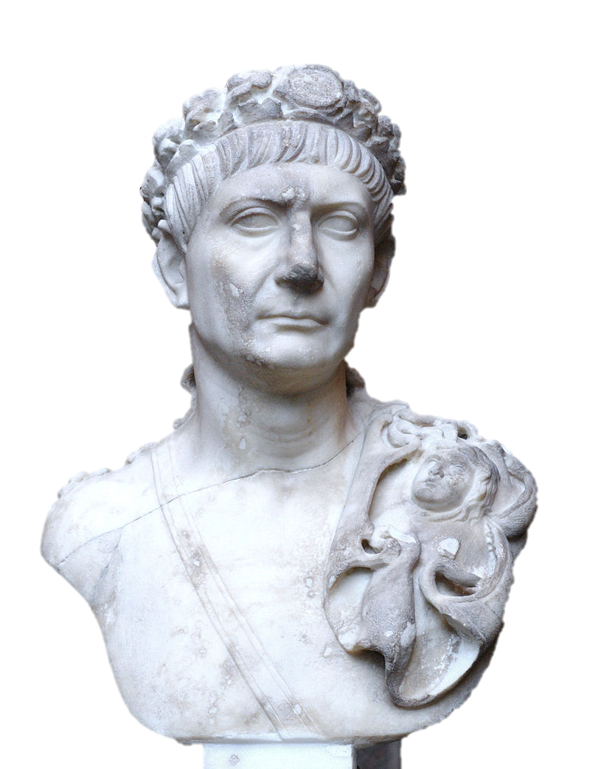
The Five good Emperors

Slide 2
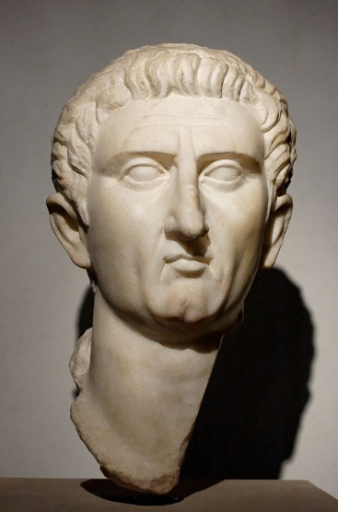
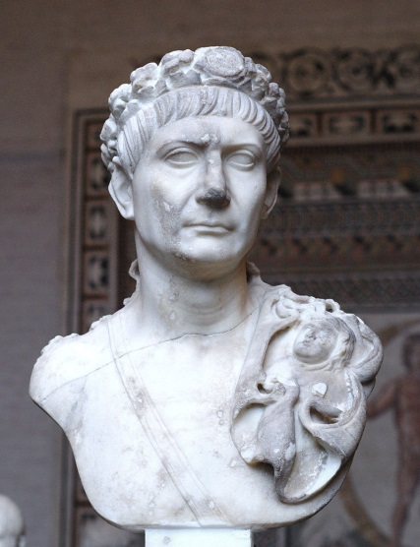
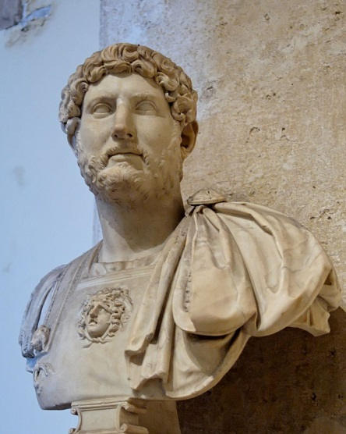
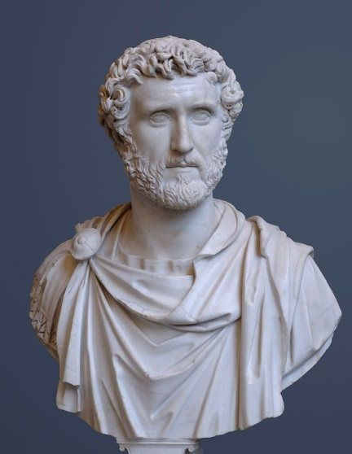
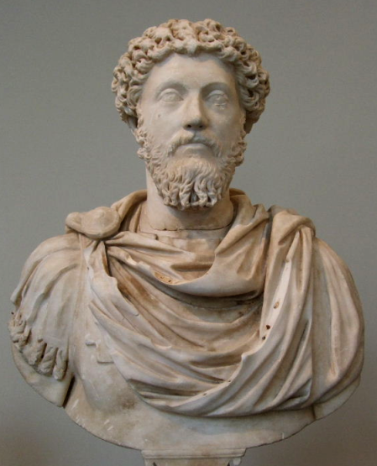
Five Good Emperors
96-180 A.D.
Nerva
96-98
Trajan
98-117
Hadrian
117-138
Antoninus Pius
138-161
Marcus Aurelius
161-180

Slide 3
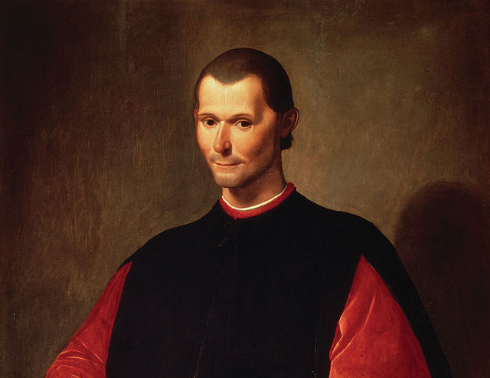
IN A ROW???

Slide 4
Machiavelli coined the term, “Five Good Emperors.”

Slide 5
meritocracy
Each emperor adopted his successor.

Slide 6
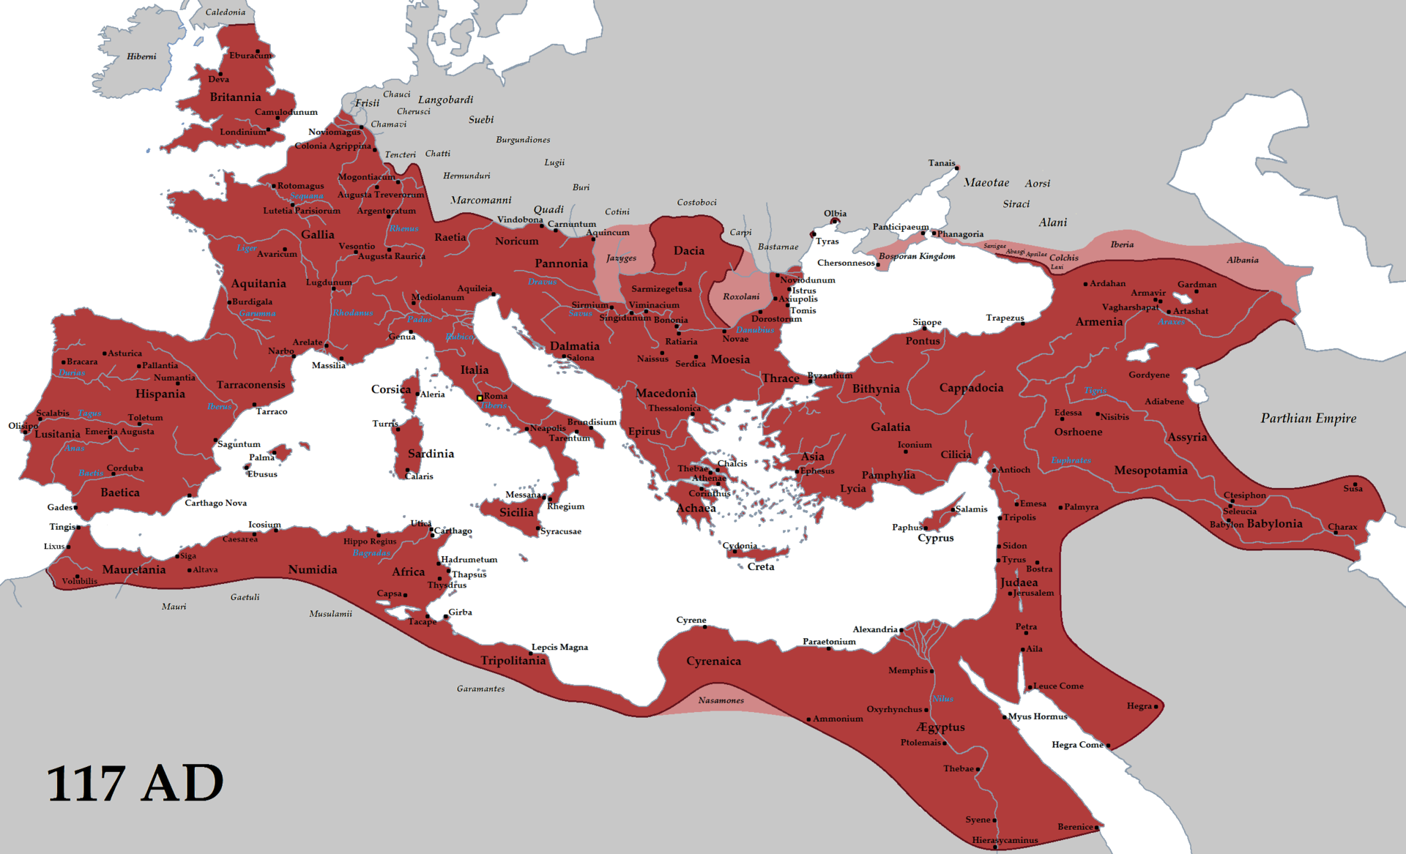
The PEAK
Map Credit: Tataryn77

Slide 7
The PEAK
Under the rule of the Five Good Emperors, the Roman Empire reached its greatest territorial extent and the Pax Romana continued.
Map Credit: Tataryn77

Slide 8
Five Good Emperors
Nerva | 96-98
Trajan | 98-117
Hadrian | 117-138
Antoninus Pius | 138-161
Marcus Aurelius | 161-180
The “Five Good Emperors” ruled in the last days of the Pax Romana.
Art Credit: Ssolbergj

Slide 9
Nerva
96-98 A.D.
Nerva set a precedent by naming Trajan, a popular young general, as his adopted son and successor.

Slide 10
Five Good Emperors
Nerva | 96-98
Trajan | 98-117
Hadrian | 117-138
Antoninus Pius | 138-161
Marcus Aurelius | 161-180
The “Five Good Emperors” ruled in the last days of the Pax Romana.
Art Credit: Ssolbergj

Slide 11
Trajan
98-117 A.D.
Optimus Princeps
(The Best Ruler)
This title was bestowed by the Senate and historians don’t tend to dispute it.

Slide 12
The PEAK
The Roman Empire reached its greatest territorial extent during Trajan’s reign.
Map Credit: Tataryn77

Slide 13
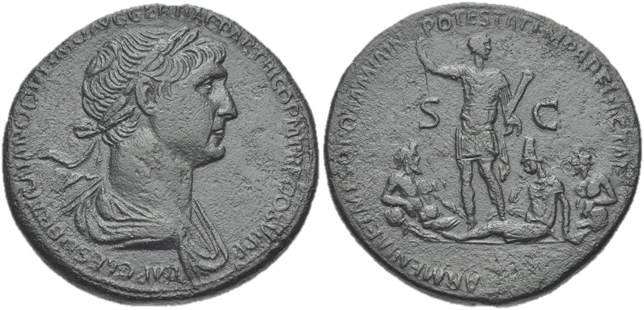
Senate-issued coinage celebrating Trajan’s victories
Photos by Classical Numismatic Group

Slide 14
Trajan’s Column
Rome, Italy
Photo by Juan Francisco Adame Lorite

Slide 15
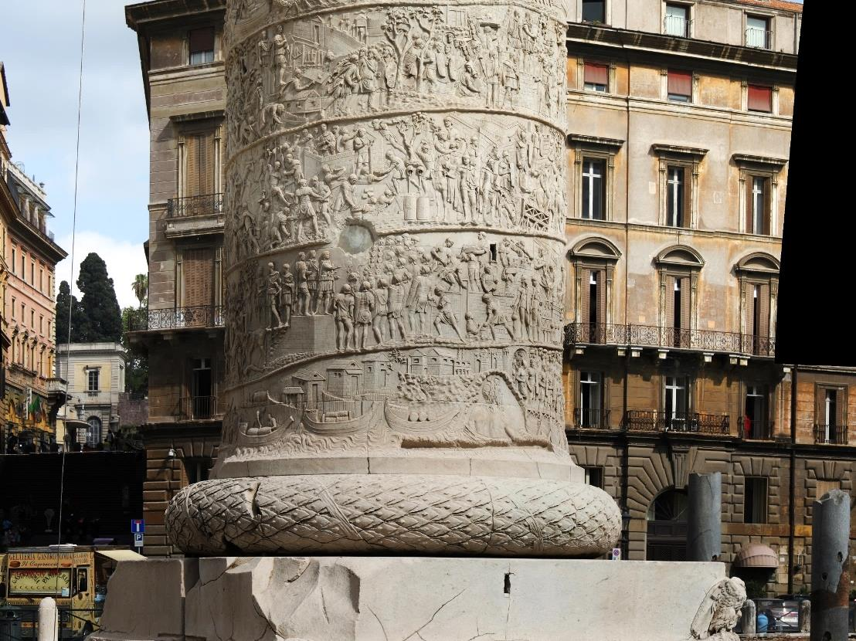
Trajan’s Column commemorates his victories in Dacian Wars.

Slide 16
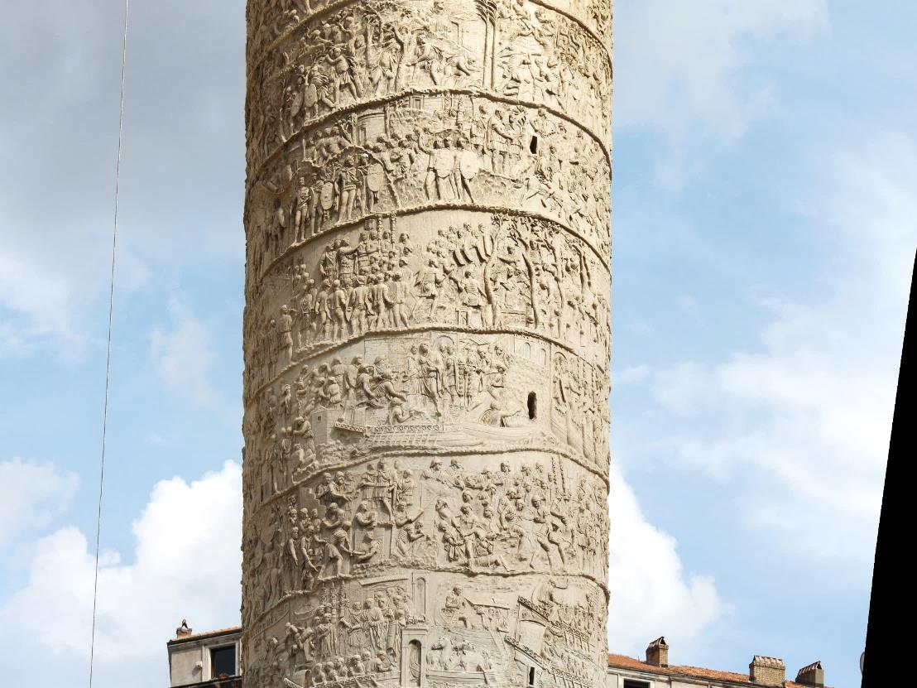
Every scene tells part of the story.

Slide 17
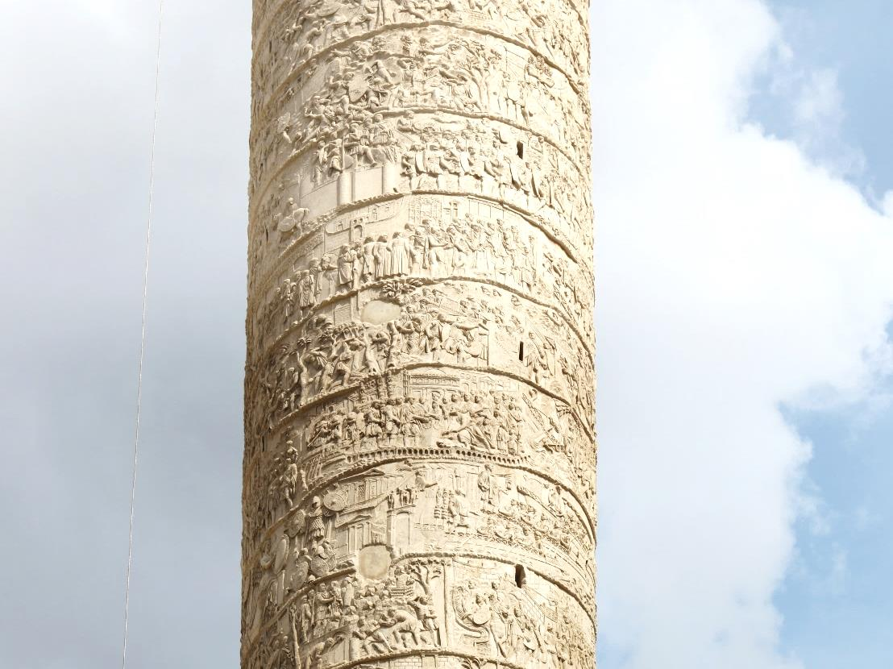

Slide 18
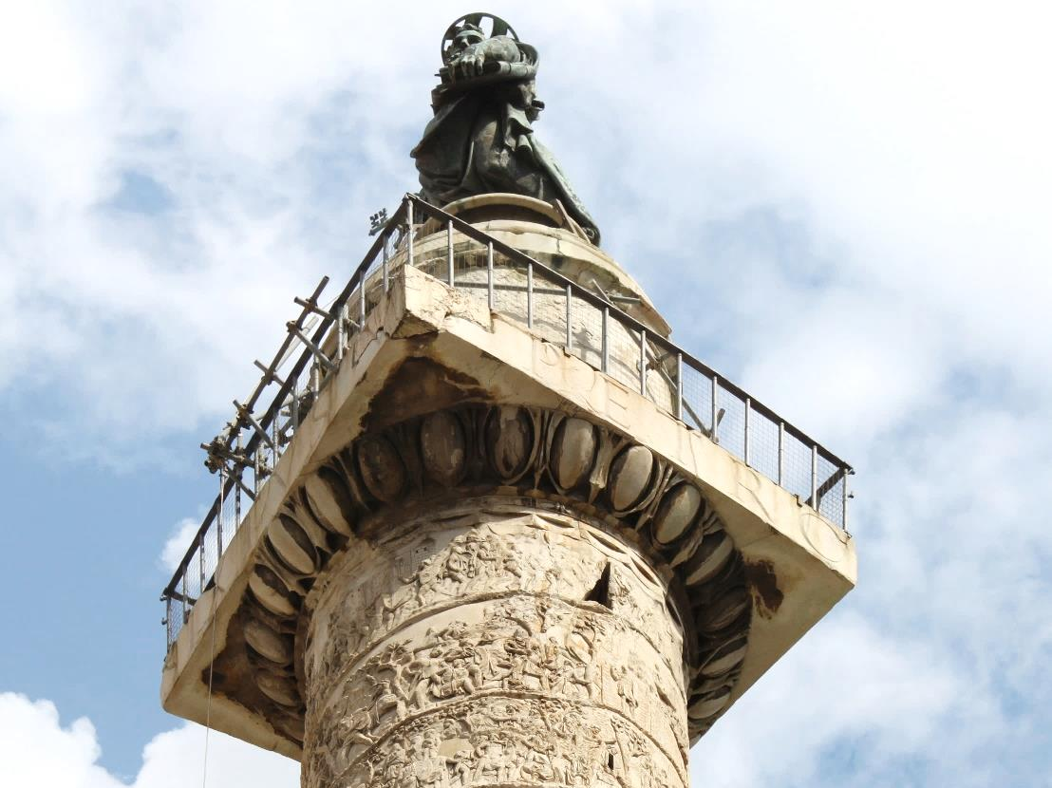

Slide 19
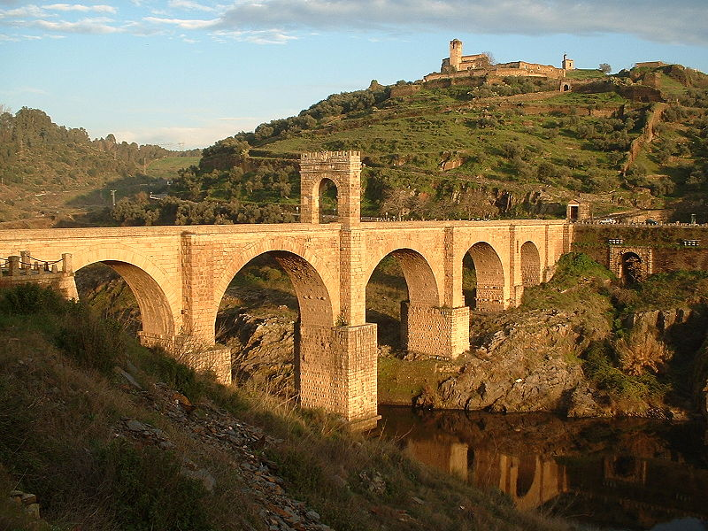
Alcántara Bridge
(Spain)
Pontem perpetui mansurum in saecula.
(I have built a bridge which will last forever.)
Photo by Dantla

Slide 20
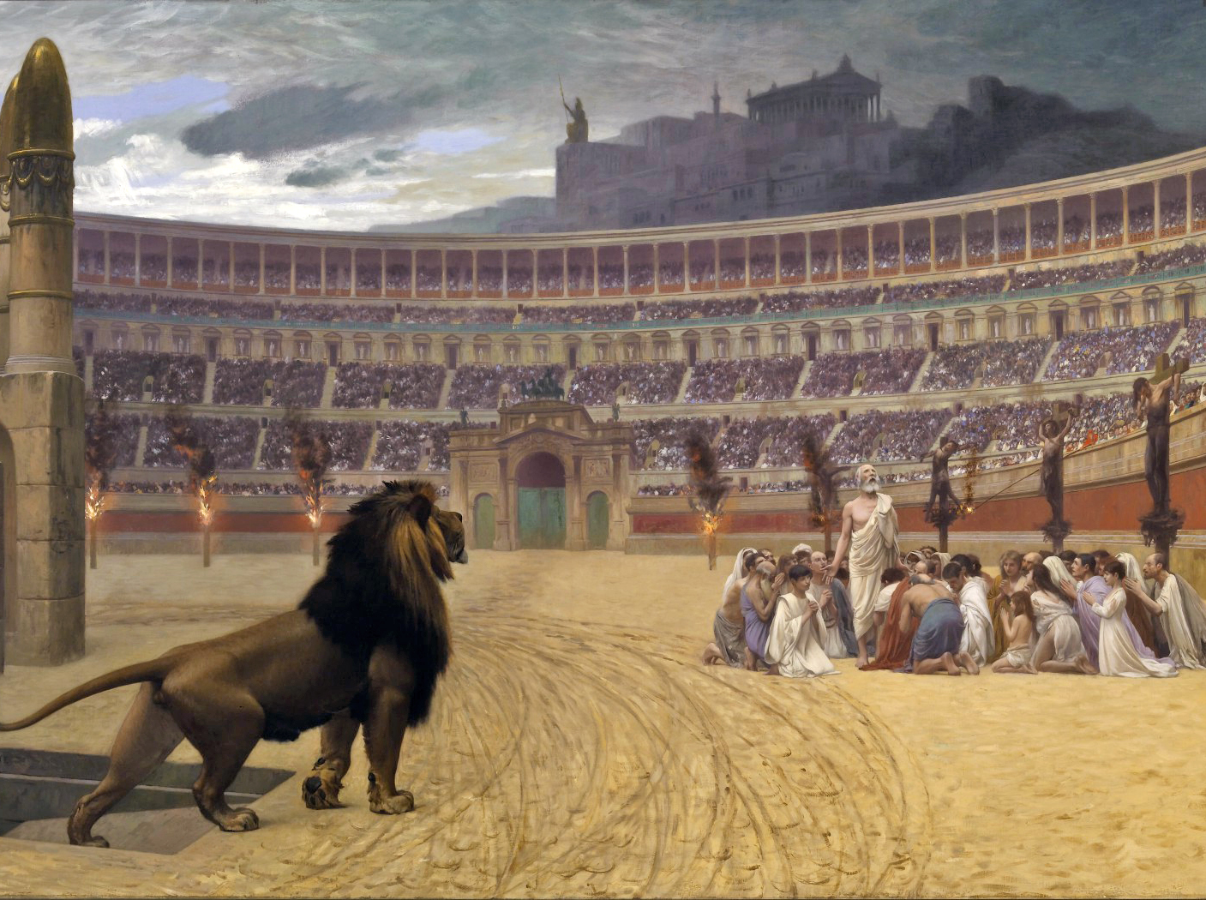
Don’t Ask. Don’t Tell.

Slide 21
“[Christians] are not to be sought out [for persecution].”
Trajan to Pliny the Younger, Roman Governor of Bithynia

Slide 22
Trajan didn’t legalize Christianity
but his policies were more liberal and tolerant than emperors before and after him.

Slide 23
Five Good Emperors
Nerva | 96-98
Trajan | 98-117
Hadrian | 117-138
Antoninus Pius | 138-161
Marcus Aurelius | 161-180
The “Five Good Emperors” ruled in the last days of the Pax Romana.
Art Credit: Ssolbergj

Slide 24
Hadrian
117-138 A.D.
Hadrian’s Wall
Bar Kokhba Revolt
Philhellenism

Slide 25
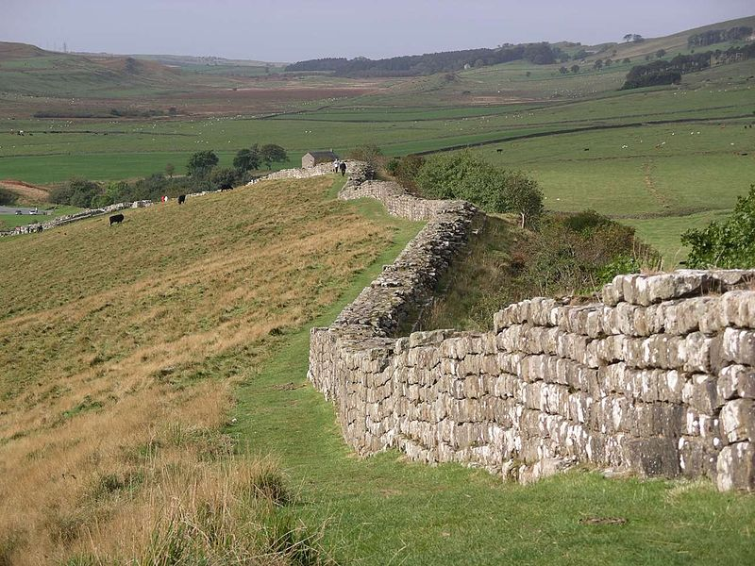
Hadrian’s Wall

Slide 26
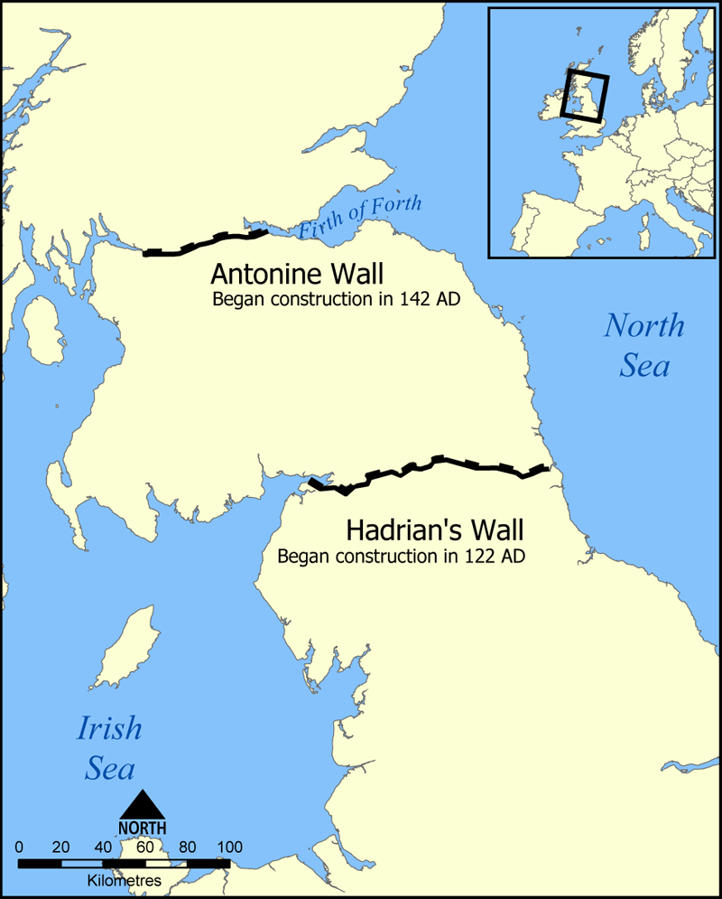
Map by Mahahahaneapneap

Slide 27
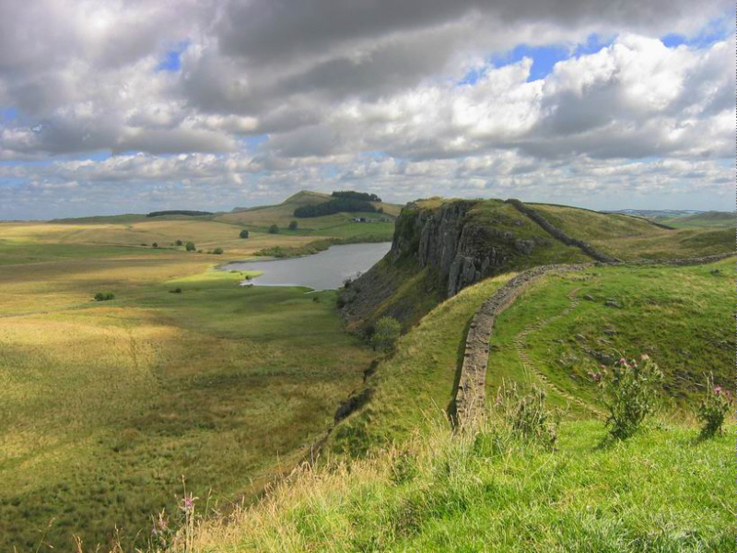
A Permanent Frontier
Photo by Michael Hanselmann

Slide 28
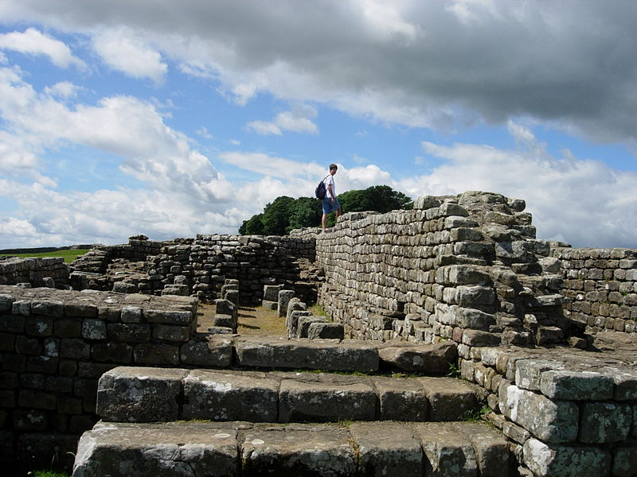
Rome shifts to the DEFENSIVE
Photo by Mark A. Wilson

Slide 29
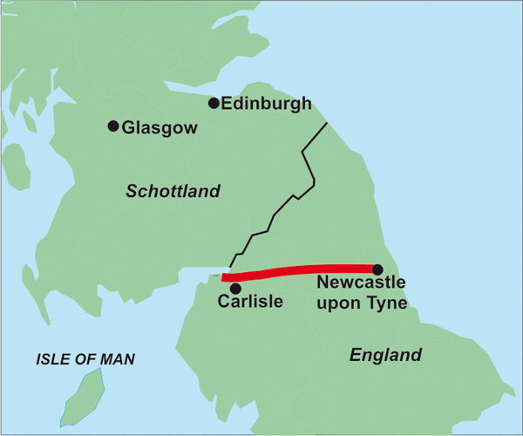
The legacy of Hadrian’s Wall
Image Source: http://geobuchhandlung.eshop.t-online.de

Slide 30
Bar Kokhba Revolt
132-136 A.D.
Simon Bar Kokhba proclaimed messiah
Independent Jewish kingdom established
Photo by zeevveez

Slide 31
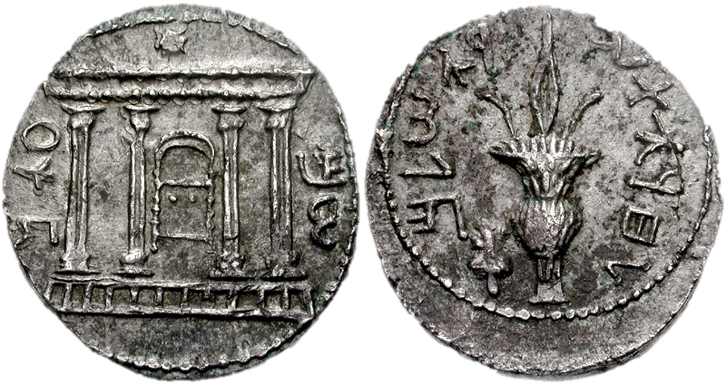
“To the freedom of Jerusalem”
Photo by CNG coins

Slide 32
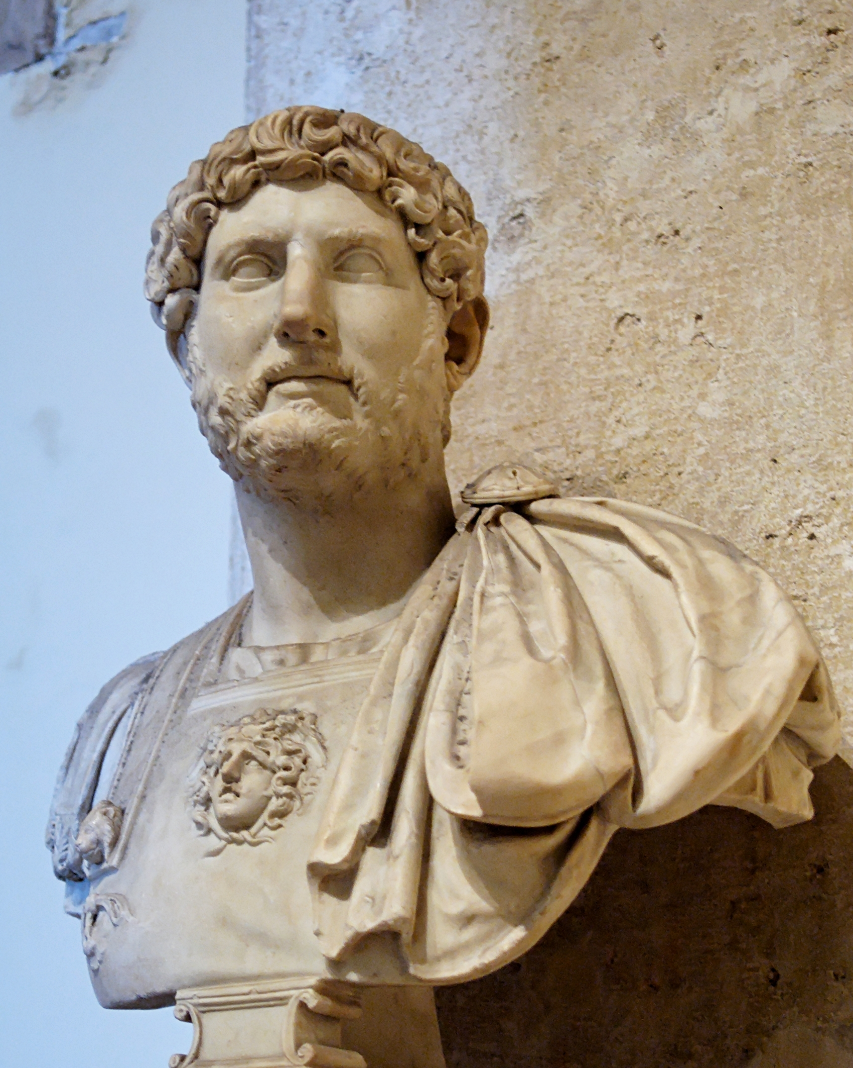
NO

Slide 33
“The [Romans] went on killing until a horse was sunk in blood up to its nose… until the blood flowed forty Roman miles into the sea…”
– Jerusalem Talmud Ta’anit 4:6
Photo by ▓▒░ TORLEY ░▒▓

Slide 34
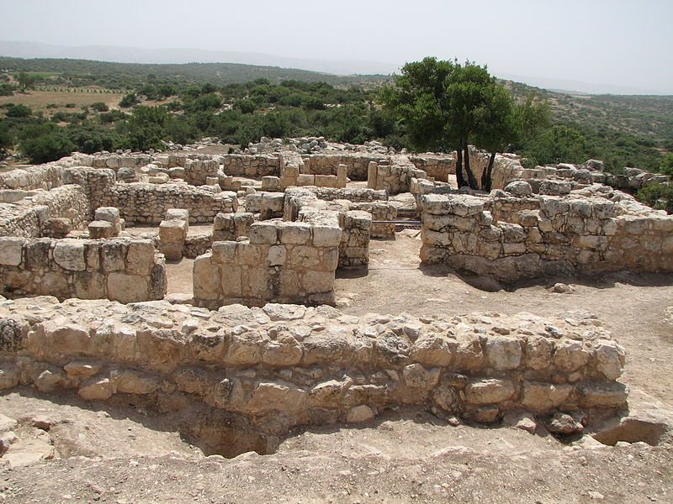
Remains of a village destroyed during the Bar Kokhba Revolt
Photo by Udi Steinwell

Slide 35
crushed
Jews Expelled from Jerusalem
Jewish Religion BANNED
Photo by zeevveez

Slide 36
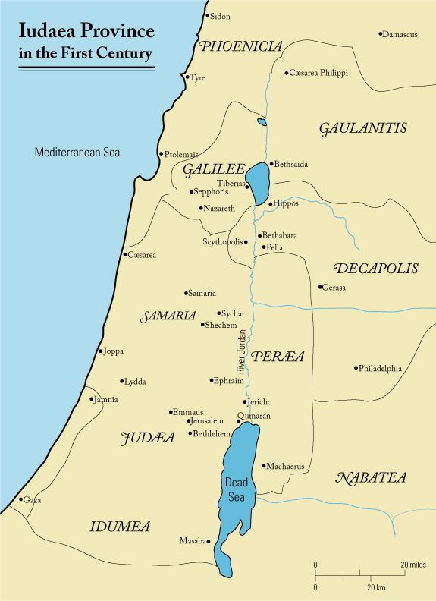
Judea
Hadrian re-named the province Syria Palaestina in order to destroy the Jewish connection with the region.
Map by Andrew c

Slide 37
Philhellenism

Slide 38
Check out my beard, yo!

Slide 39
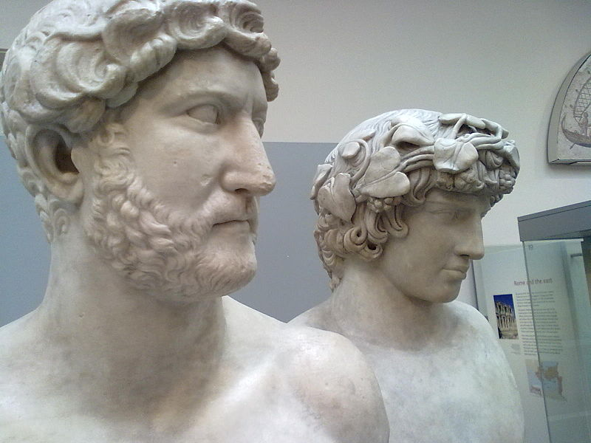
Hadrian &Antinous
Photo by SanGavinoEN

Slide 40
“During a journey on the Nile he lost Antinous, his favourite, and for this youth he wept like a woman.”
-- The Augustan History

Slide 41
Five Good Emperors
Nerva | 96-98
Trajan | 98-117
Hadrian | 117-138
Antoninus Pius | 138-161
Marcus Aurelius | 161-180
The “Five Good Emperors” ruled in the last days of the Pax Romana.
Art Credit: Ssolbergj

Slide 42
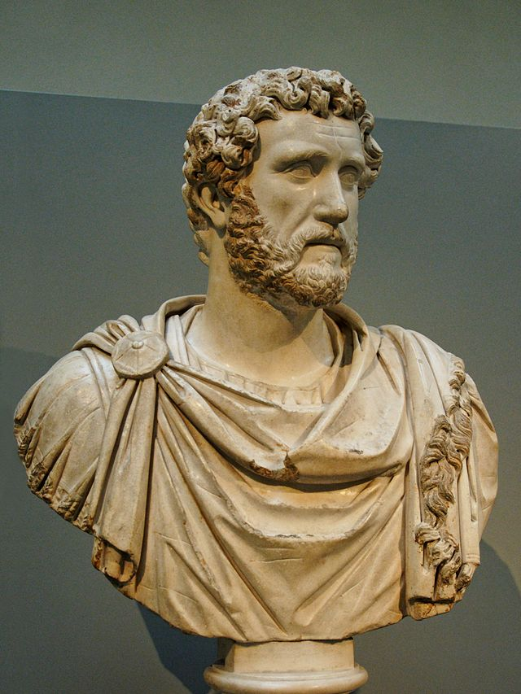
Antoninus Pius
138-161 A.D.
“Throughout the twenty-three years of his reign, he never went within five hundred miles of a legion.“
-- J.J. Wilkes
Photo by Jastrow

Slide 43
Five Good Emperors
Nerva | 96-98
Trajan | 98-117
Hadrian | 117-138
Antoninus Pius | 138-161
Marcus Aurelius | 161-180
The “Five Good Emperors” ruled in the last days of the Pax Romana.
Art Credit: Ssolbergj

Slide 44
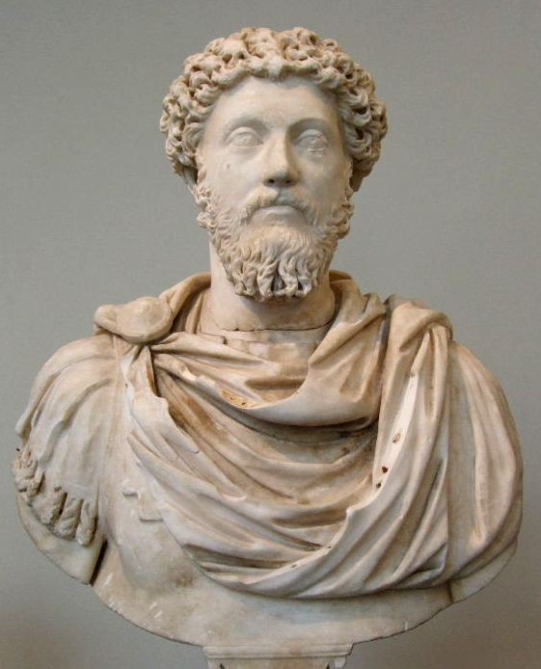
Marcus Aurelius
161-180 A.D.
Stoic Philosopher
Meditations

Slide 45
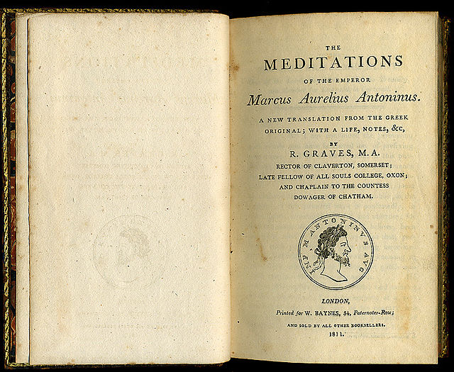
VIII. 47
“If thou art pained by any external thing, it is not this that disturbs thee, but thy own judgment about it. And it is in thy power to wipe out this judgment now.”

Slide 46
IV. 7
“Take away your opinion, and there is taken away the complaint...
Take away the complaint... and the hurt is gone.”

Slide 47
IV. 50
“Do not then consider life a thing of any value. For look at the immensity of time behind thee, and to the time which is before thee, another boundless space. In this infinity then what is the difference between him who lives three days and him who lives three generations?”

Slide 48
ALL GOOD THINGS...
Marcus Aurelius was a smart guy... but he ruined it.

Slide 49
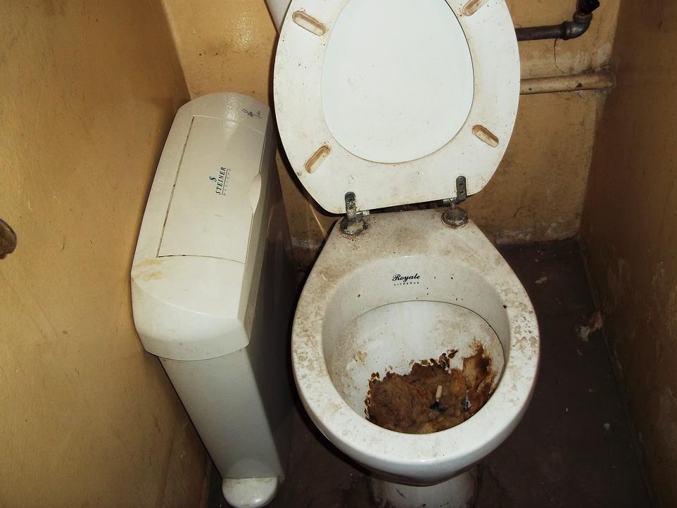
COMMODUS
Photo by SuSanA Secretariat

Slide 50
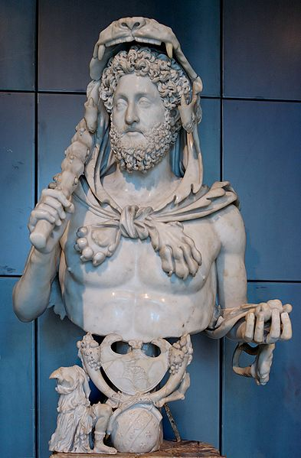
Commodus
180-192 A.D.
Natural son of Marcus Aurelius
EGOMANIAC
GLADIATOR
Commodus as Hercules

Slide 51
COMMODUS
Many historians view Commodus’ reign as the begin of the Roman Empire’s decline.
Photo by SuSanA Secretariat

Slide 52
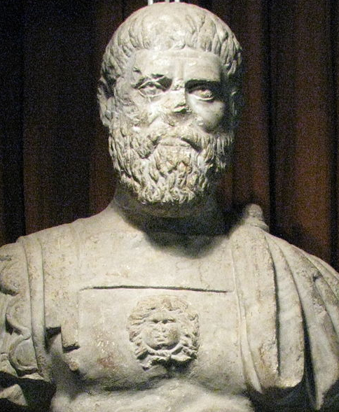
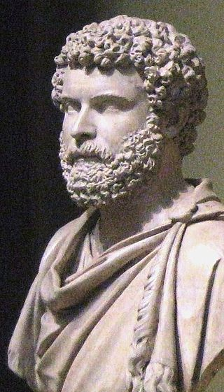
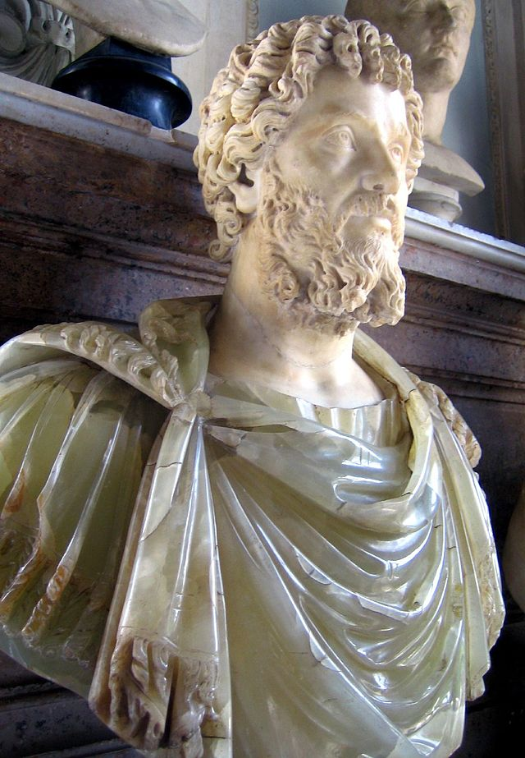
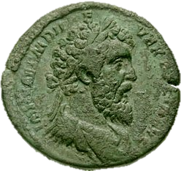
The Year of the Five Emperors
193 A.D.
Photo by Codrin.B
from CNG coins
Photo by Shakko
Photo by antmoose

Slide 53
END PAX ROMANA
Photo by Codrin.B
from CNG coins
Photo by Shakko
Photo by antmoose

